Slide 1
National Consultation
Framing Climate Agenda Towards Climate Resilient and Carbon Neutral Afghanistan
Case Study 1: Climate-Induced Disasters
Ezattullah Sediqi, Advisor to the State Minister, SMDM/ANDMA
Date: 9 July 2018

Slide 2
Country Risk Profile

Slide 3
Country Risk Profile
Located in an area of high-seismic activity,
Extreme climate and harsh geo-physical conditions
Climate change and Environmental Degradation
More than three decades of conflict has caused huge human loss, resulted in:
  Millions of refugees,
  Infrastructure damage, and
  Slow developmental progress
Notes:
International Disaster Response Law (IDRL) in Afghanistan

Slide 4
Country Risk Profile
Afghanistan is prone to natural disasters:
    Earthquakes
    Flooding
    Droughts
    Landslides
    Avalanches and
    Sandstorms
Afghanistan is prone to Man-made disasters:
  conflicts
  IDPs
  Plane crash
  Traffic incidence
  Fires
  Attacks, war…
Notes:
International Disaster Response Law (IDRL) in Afghanistan

Slide 5
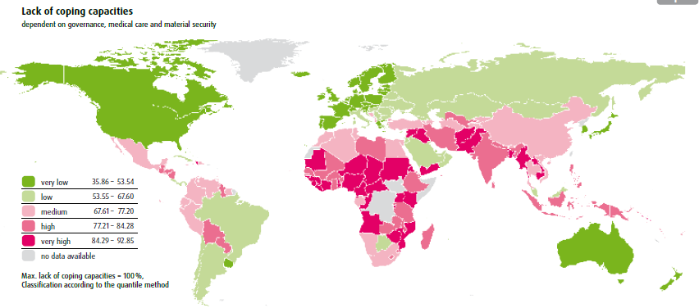
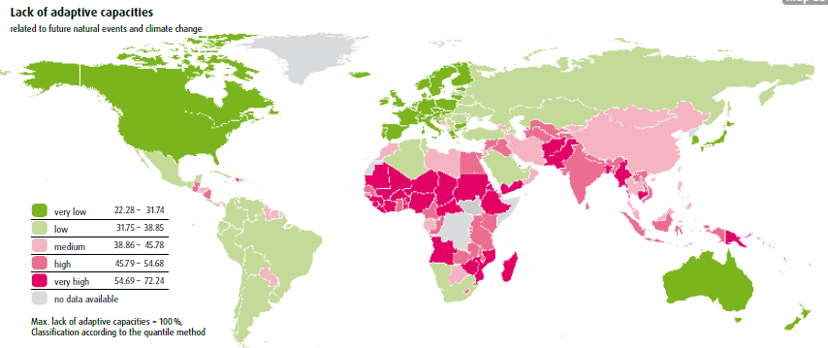
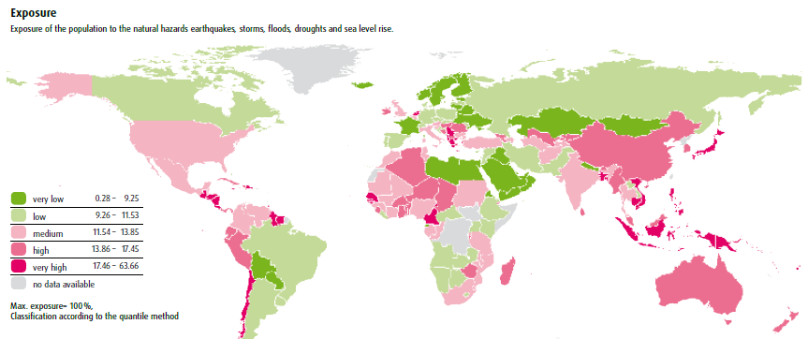
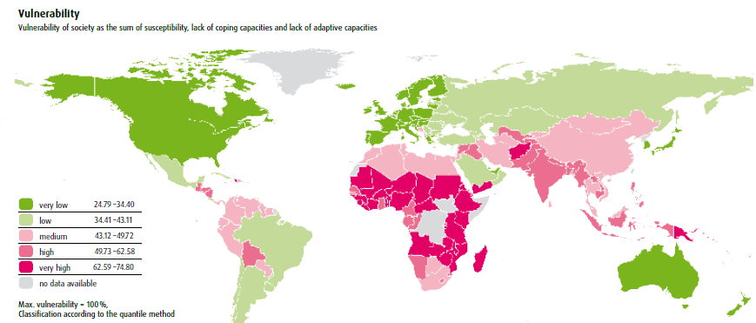
Notes:
World Risk Report 2016

Slide 6
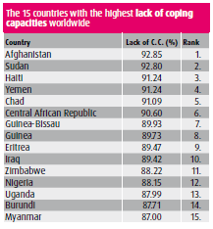
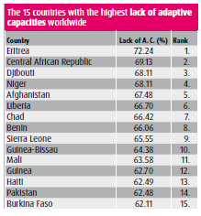
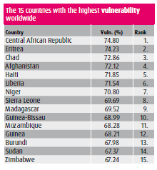
World Risk Report 2016
Notes:
World Risk Report 2016

Slide 7
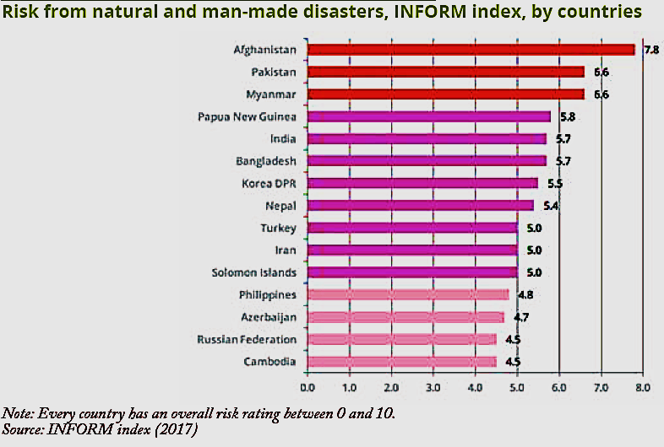
Asia Pacific Disaster Report 2017
Notes:
Asia Pacific Disaster Report 2017, page 24

Slide 8
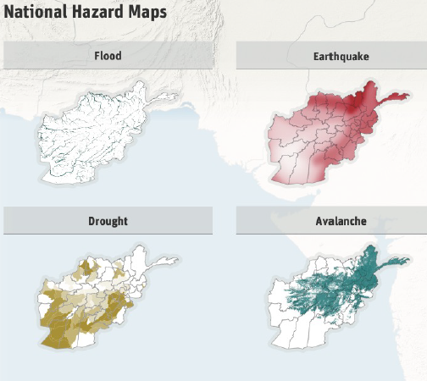
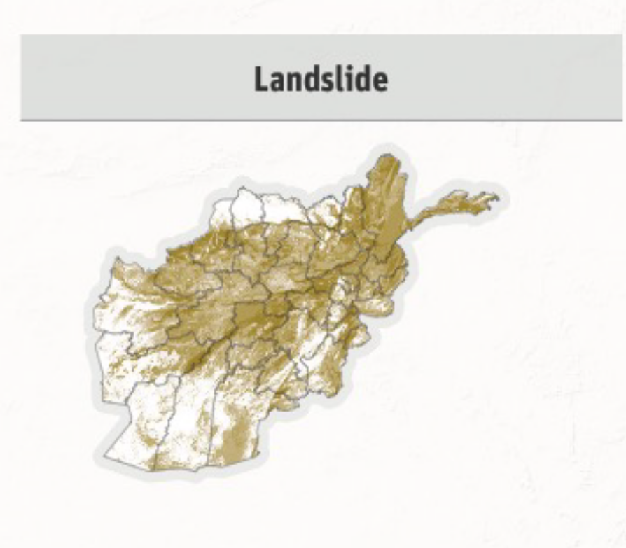
Notes:
Geonode website

Slide 9
Climate Induced Disasters

Slide 10
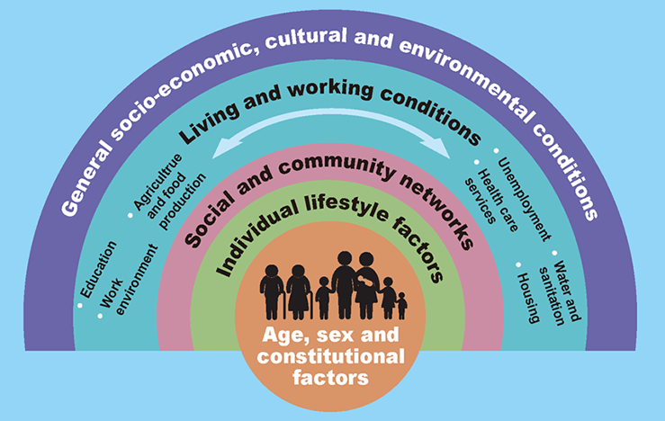
Environment and Human

Slide 11
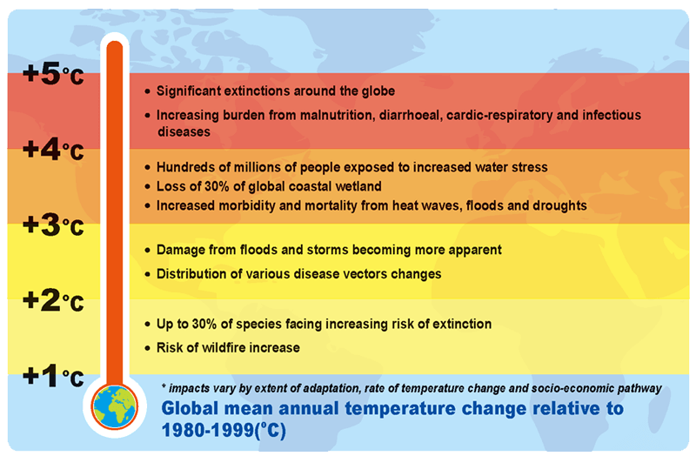
Climate Change Scenarios

Slide 12
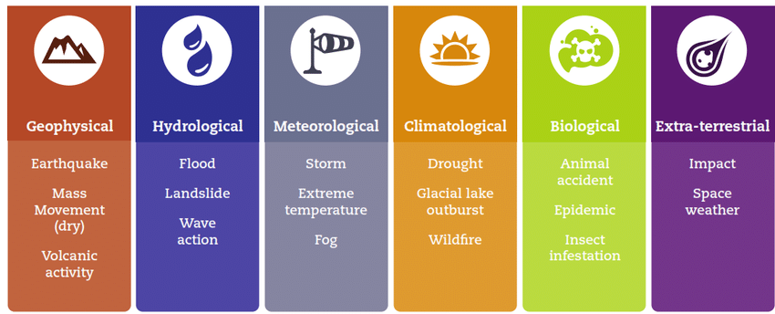
Types of Disasters

Slide 13
Recent Case
Severe Drought
  20 Provinces, affected mainly rain-fed agriculture and irrigation agriculture
  13 million people live in the 20 provinces
  3.5 million livestock is affected
  1.4 million people needs humanitarian assistances
  Drinking water, diseases, poverty, security…challenges
Floods – happened in the same time in the same provinces
Notes:
International Disaster Response Law (IDRL) in Afghanistan

Slide 14
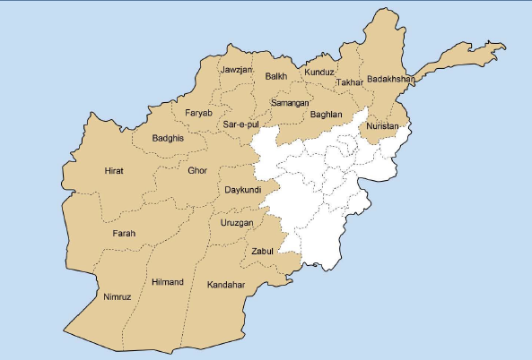
20 Drought Affected Provinces
Notes:
FAO Drought Rapid Assessment, 2018

Slide 15
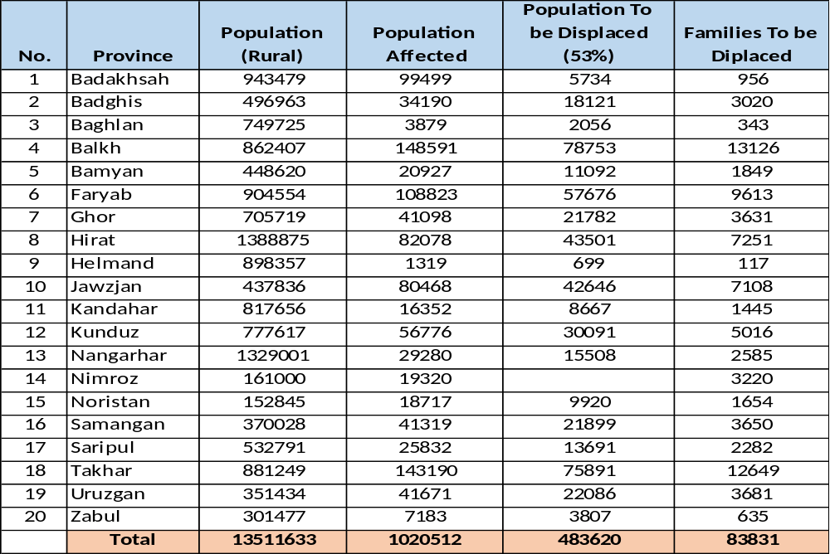
Population Affected by Drought and Floods in 20 Provinces of Afghanistan

Slide 16
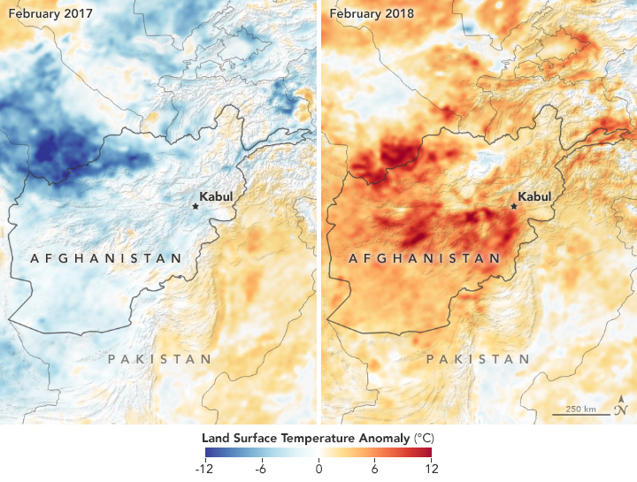
Land Surface Temperature

Slide 17
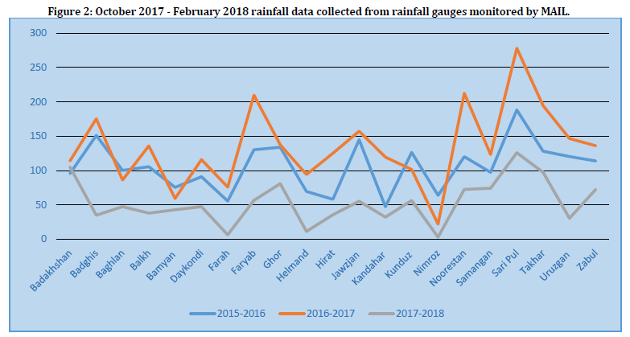
Precipitation Reduction

Slide 18
Afghanistan
SMDM/ANDMA

Slide 19
Scope of Work
Providing strategic leadership, policy direction covering all aspects of disaster preparedness, mitigation and response on behalf of the Afghan Government.
Coordinating donor-funded interventions by the international community and UN agencies in support of disaster preparedness, mitigation and emergency response, including mine clearance.
Notes:
International Disaster Response Law (IDRL) in Afghanistan

Slide 20
DMS in Afghanistan
Institutional Arrangement
  Afghanistan National Disaster Management Authority (ANDMA)
  National Disaster Management Commission (NDMC)
  Provincial Disaster Management Commission (PDMC)
  District Level Disaster Management Commission (DDMC)
  Local – CDCs, NGOs, CSOs,..

Slide 21
Achievements and Way Forward

Slide 22
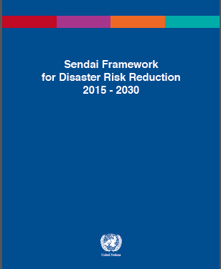
Sendai Framework
Sendai Framework – 2015 – 2030
Country Status Report
Implementation Roadmap for SFDRR
National Consultation Workshops – February, August, November 2017
Orientation and Capacity building Programs
Translation of SFDRR

Slide 23
Seven Targets of SFDRR
TARGETS
NO OF DEATHS
NO OF AFFECTED PEOPLE
ECONOMIC LOSS
DAMAGE TO EDUCATION AND MEDICAL
NATIONAL AND LOCAL STRATEGIES
SUPPORT DEVELOPING COUNTRIES
EARLY WARNING AND INFORMATION
OUTCOME-”The Substantial reduction in disaster risk and losses in lives, livelihood and health and in the economic physical, social, cultural and environmental assets of persons business, communities and countries.”

Slide 24
WB – DRM Project
Funded by World Bank – 2015
  Country Risk Proline
  Hydrometeorological Services and EWS
  Capacity Assessment – Strategic Framework

Slide 25
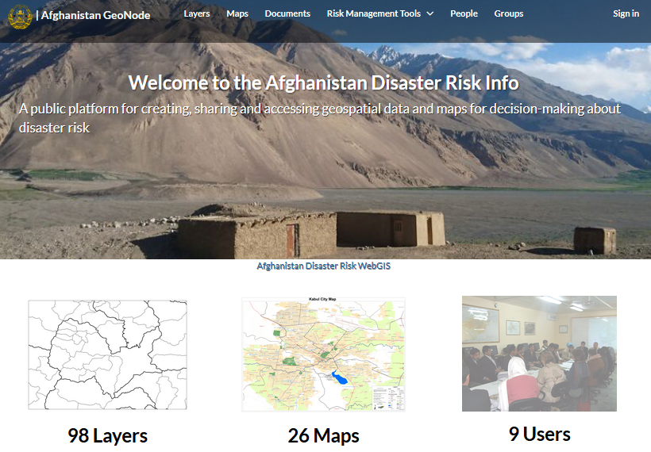
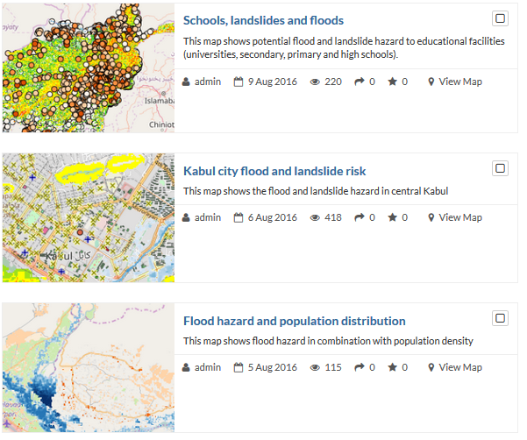

Slide 26
Nat. Disaster Management Information System
Funded by Japan and implemented by – IOM
Development and installation of the database in 10 Provinces
ANDMA Website is developed
Capacity building programmes ongoing

Slide 27
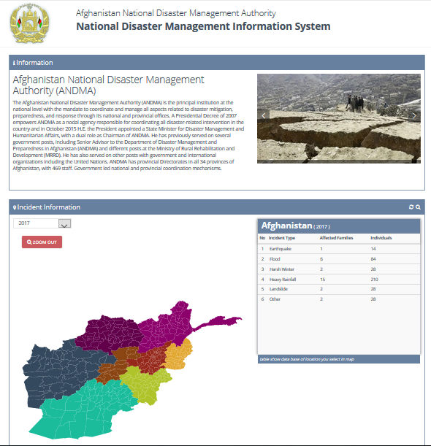

Slide 28
Ongoing

Slide 29
Needs and Requirements
Capacity building programmes
  Training programmes
  Orientation visits
  Exchange of experts
Transfer of technology
  Search and Rescue
  Mapping, GIS, RS, risk assessment methods

Slide 30
Needs and Requirements
Standard Emergency Operation Centers
Standard Early warning system
Establishment of Database
Support along the Sendai Framework implementation
  Policies, strategies and plans development

Slide 31
Recommendations

Slide 32
Stakeholders - Coordination
Government – Ministries and Agencies
Academic Institutions - Research
DRM
CSOs – NGOs – DRR, Public Awareness
UN Agencies – Technical Support
International and Regional Organizations
(C.C, SF, SDGs…)

Slide 33




Relationships
Together, the Sendai Framework on Disaster Risk Reduction, Sustainable Development Goals, Paris Agreement on Climate Change, cover a spectrum of risks. In a significant shift, they even acknowledge and cross-reference each other, looking at underlying vulnerabilities and cross-cutting issues.
YAKOHAMA STRATEGY
IDNDR
HYOGO FRAMEWORK
ISDR
SENDAI FRAMEWORK

Slide 34
Thank you
Q&A

