Slide 1
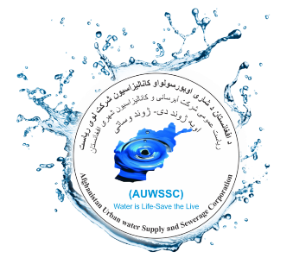

Afghanistan Urban Water Supply and Sewerage Corporation
(AUWSSC)
Urban Water Supply and Sanitation Situation
Current State, Projects, Plans
Presented at:
National Consulting Framing Climate Agenda Towards Climate Resilient
and Carbon Neutral Afghanistan
July 2018
Kabul, Afghanistan
Notes:
WELCOME SCREEN → “All Content is editable –and- or you can put your logo on there”
Please Read this Notice Before you start working with this Template
Please Install the following Fonts and/or make sure its already available on your system.
Open Sans Family
Available @ fontsquirell.com
Callibri
Microsoft & Office System Font

Slide 2

GENERAL INFORMATION
Background
AUWSSC was established on 11th August 2007, by a Presidential Decree. The main goal and the objectives of AUWSSC are to ensure sustainable provision of safe drinking water supply and sewerage services to all urban areas of the Islamic Republic of Afghanistan. It has 6 SBUs and it has the following Departments in the HQ:
Technical department
Financial and Administrative department
Operational department
Wastewater Management department
Procurement department
HR department
Internal Audit department

Slide 3
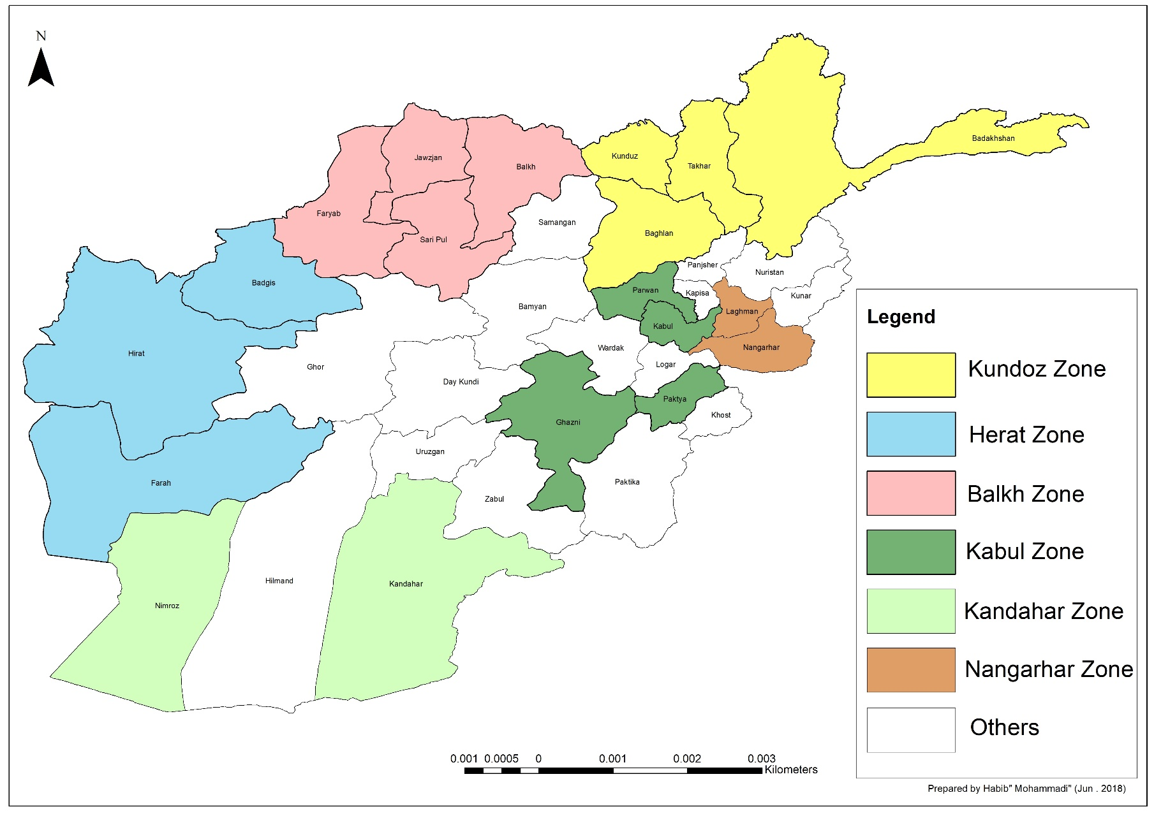
GENERAL INFORMATION
AUWSSC Active SBUs and Sub SUBs
Currently there are six SBUs in AUWSSC which are organized as shown

Slide 4
GENERAL INFORMATION
Background (Technical Directorate)
Technical Directorate is one of the main directorates is AUWSSC which is responsible for the Panning, Design, Development, Implementation and Monitoring of the projects. It has 27 members within the following four departments:
Planning Department
Project Development Department
Project Implementation and Monitoring Department
Project Implementation Unit for shahtoot dam distribution network, PIU

Slide 5
GENERAL INFORMATION
Cooperation with Donors
KfW
    KfW mainly cooperate with AUWSSC on new projects implementation in Kabul, North and Northeast cities. Currently there is a new module appraisal: Water and Sewage Regional Centers which will focus on four northern cities of Talaqan, Faizabad, Mazar e Sharif and Aybak; and including Herat city (NC III). Additionally, they are also working on AUWSSC’s sanitation master plan for Kabul city.
GIZ
    GIZ mainly have a role in capacity building and technical support of the AUWSSC staff focusing on Kabul, Mazar and Kunduz.
    USAID
        They have initially invested on an MTP1 project alongside with KfW and AFD which the project is leding by KfW as representative of other donors. USAID have also partially will cooperated AUWSSC water supply extension and improvement.
    AFD
        They have initially invested on an MTP project alongside with KfW and USAID which the project was led by KfW as representative of other donors. Additionally, AFD plans to fund a project on Kabul Water Supply System Modernization.

Slide 6
GENERAL INFORMATION
Cooperation with Donors (Cont’d)
    World Bank
        They have supported AUWSSC during its transformation into a corporation in 2007, and have continued their support in capacity building and policy making till 2014. Additionally, WB have started a project to build water supply system in 14 provinces with the approximated cost of 8.9 M $ which was later stopped due to problems in management and implementation of the projects in 2010. WB will support Shah toot Dam distribution network in district: 6, 7 & 13.
    CIDA
        They have worked on some projects in Kanadahar City.
    UN-Habitat
        They have worked on some projects in Kanadahar and Jalalabad cities.
    JICA
        They have done several studies regarding the water supply and sanitation including New Kabul, Kabul City Master Plan, Groundwater quality, and dam feasibility study and surface water utilization for drinking purposes. Additionally, they have been a partner of AUWSSC in capacity buildings and trainings programs.

Slide 7
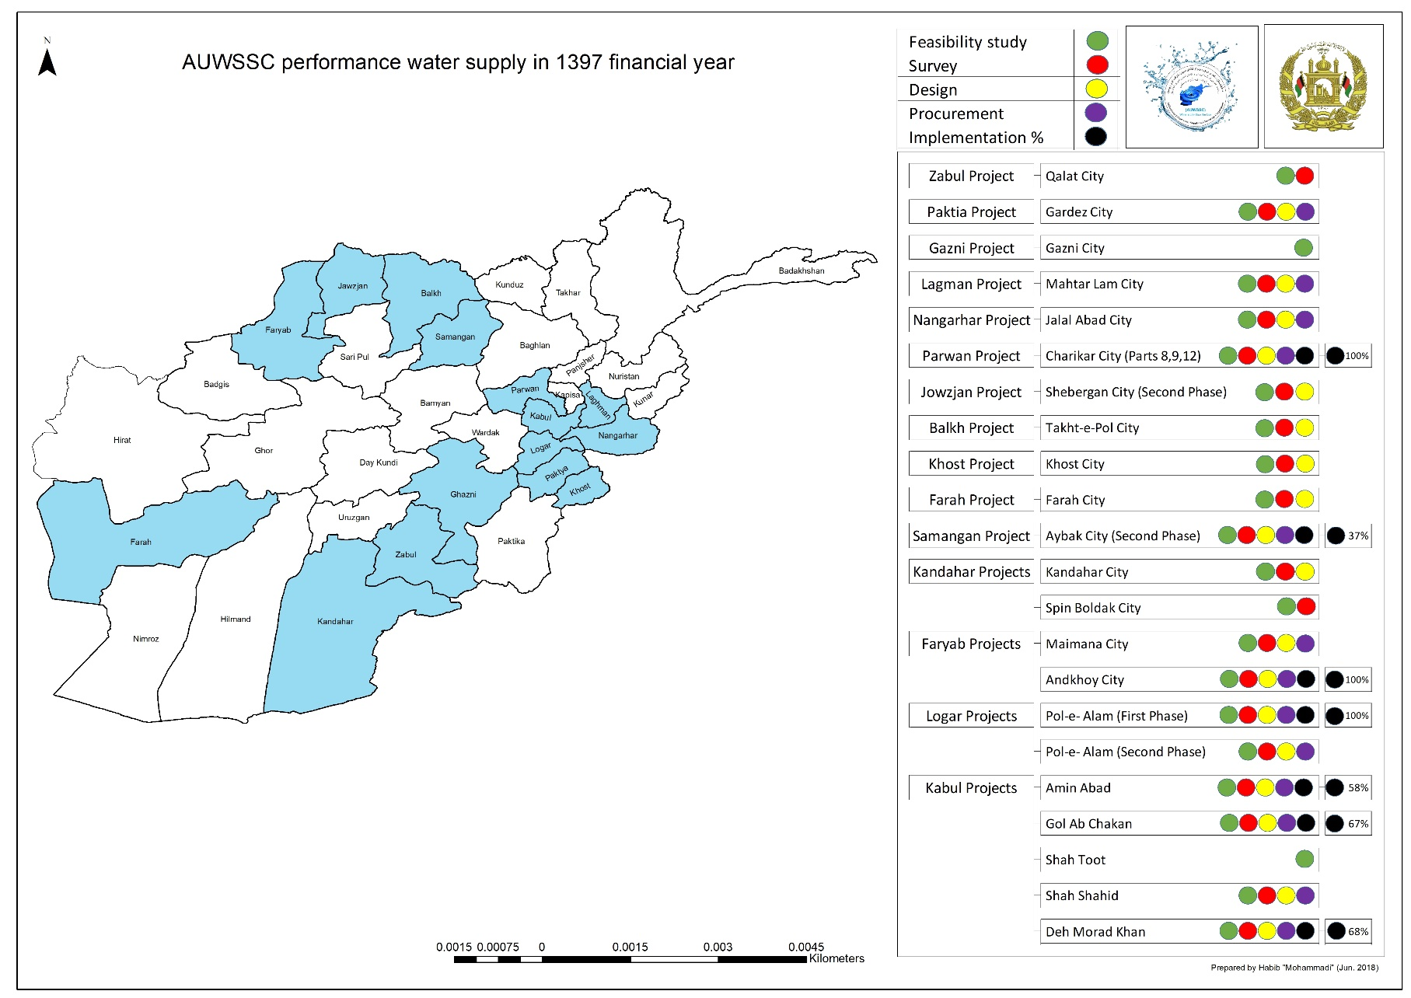
GENERAL INFORMATION
Ongoing Projects
The ongoing projects on Water Supply improvement

Slide 8
GENERAL INFORMATION
Survey and Design Projects
THE ONGOING SURVEY AND DESIGN PROJECTS
PERFORMED BY AUWSSC
on
Water Supply improvement

Slide 9
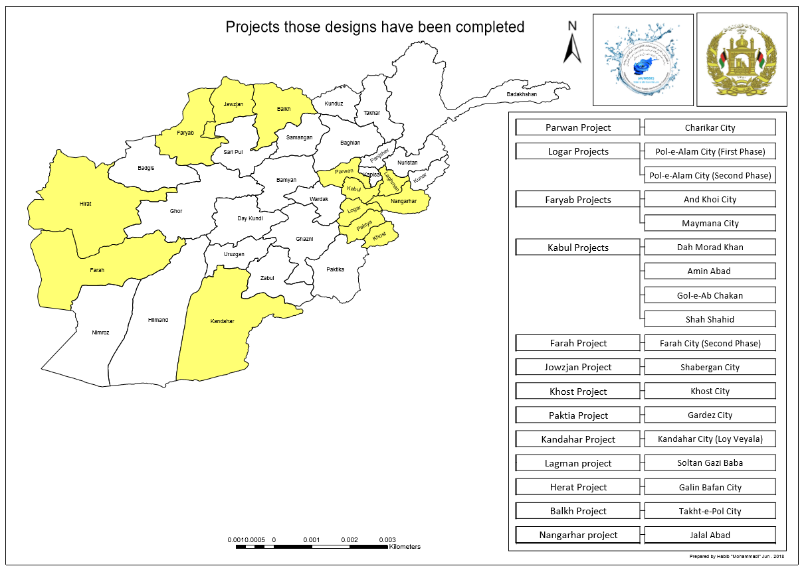
GENERAL INFORMATION
Survey and Design Projects
Design have been completed

Slide 10
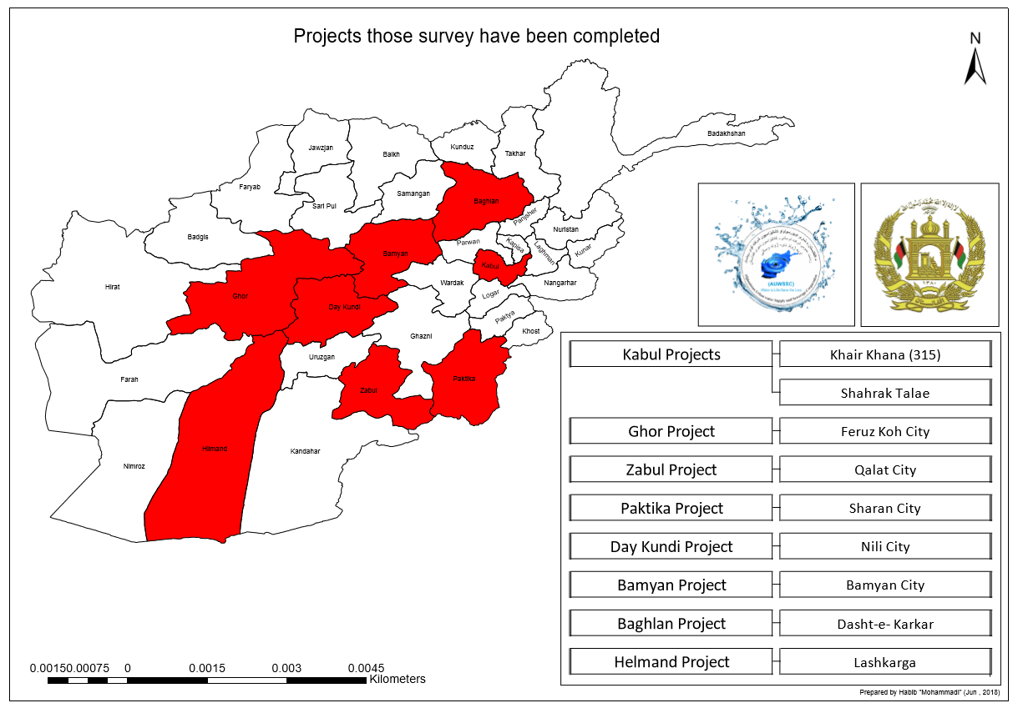
GENERAL INFORMATION
Survey and Design Projects
Survey have been completed

Slide 11
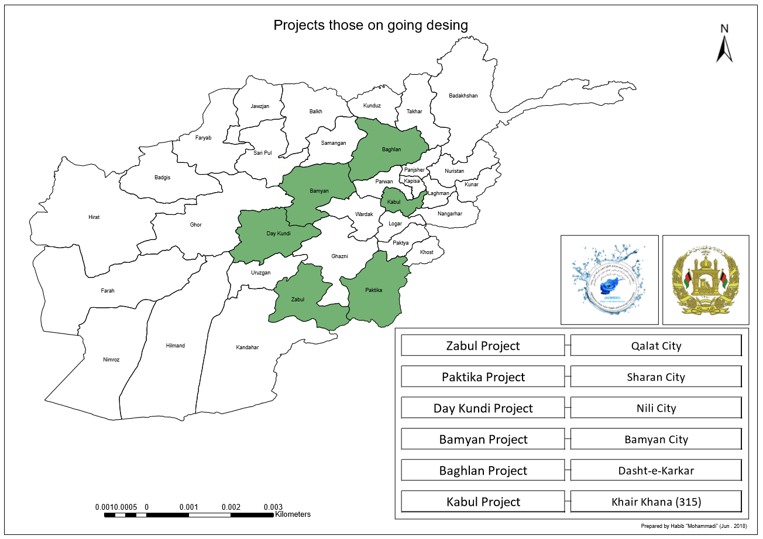
GENERAL INFORMATION
Survey and Design Projects
Design is ongoing

Slide 12
OPERATIONAL INFORMATION
Background
The current Status of AUWSSC
from the
Operational Prospective

Slide 25
WASTEWATER MANAGEMENT DEPARTMENT INFORMATION
Background
The current Status of AUWSSC
WWMD Responsibilities
AUWSSC Wastewater Department planning
AUWSSC Wastewater Department Ongoing and Done activities.

Slide 26
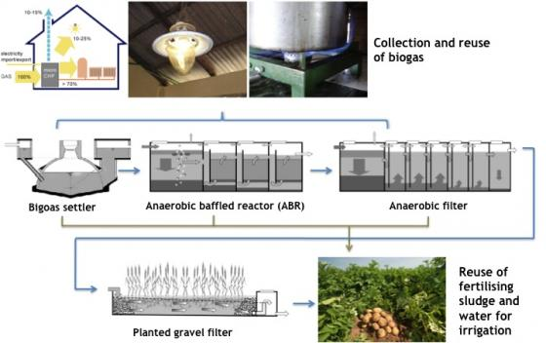
Wastewater Management Department
WWMD Responsibilities
Preparation and development of plans and programs related to the utilization of urban sewage networks and optimal use of facilities in the framework of approved policies and programs in accordance with the AUWSSC rules.
Data Compilation related to operation of network and maintenance of related equipment and provision of cities statistical reports related to wastewater disposal.
Follow up and monitoring from creation and operation of wastewater treatment plants.
Preparation and formulation of guidelines for activities coordinating and ensure the proper performance of sewage quality control activities.
Identifying and reviewing industrial facilities and encourage them to establish sewage treatment networks.
Supervising the strict implementation of tariffs and their compliance with AUWSSC regulations.
wastewater treatment services in covered area.
Provide training on maintenance for the people referred to from the relevant reference.

Slide 27
Wastewater Management Department
AUWSSC Wastewater Department planning
Training technical and professional staff in order to provide better wastewater services.
Giving domestic and foreign assistance to train cadres, equipping sewage facilities and supplies of materials needed by Demands.
Establishing labs equipped to determine the quality of drinking water and wastewater treatment after treatment in accordance with international norms.
To become a member of the regional and international associations of sewage systems in accordance with the provisions of the law
Cooperation Contract in sanitation and modernization of working system with national and international organizations.
Monitoring of sanitation services and collecting of Tariffs.
Surveying and studying of sanitation projects in cooperation of national and international experts.
Management of wastewater systems
Provision of standard sanitation services in Kabul and urban areas.

Slide 28
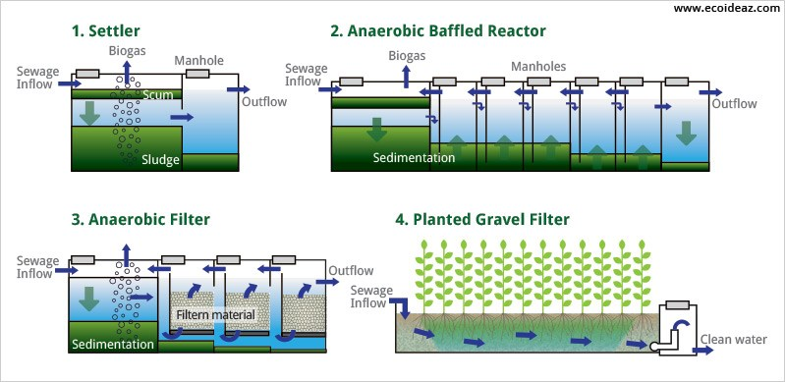
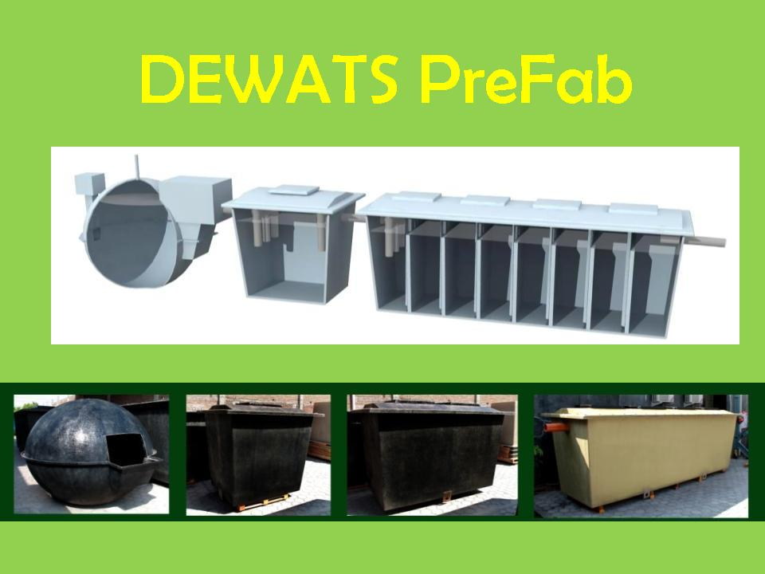
Wastewater Management Department
WWMD Ongoing and Done Activities
Survey and Design of governmental institutions for construction DEWATS and Mechanical centralize wastewater treatment systems.
Implementation of Kabul Sanitation Master plan according to JICA prepared master plan for Kabul City.
Shit Flow Diagram SFD graph preparation for 5 major cites.
Wastewater concept for Kabul University to presidential palace for construction of mechanical centralized wastewater treatment system.
Wastewater department creation in AUWSSC SBU’s.
DEWATS survey and design have been completed for 18 governmental institutions.

Slide 29
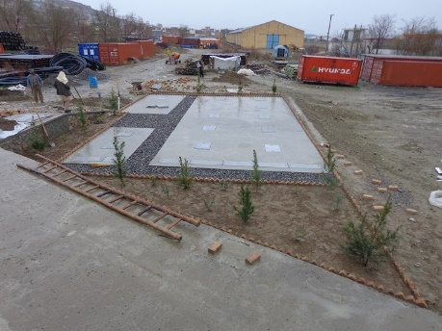
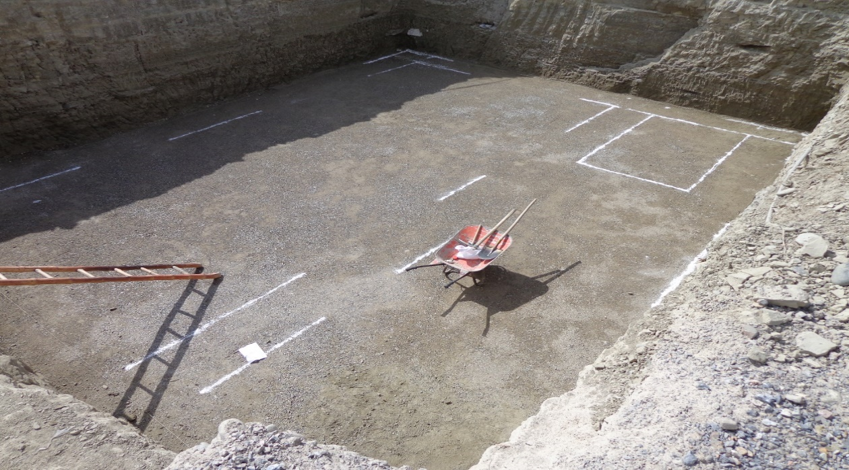
Wastewater Management Department
AUWSSC Decentralized Wastewater Treatment System

Slide 30
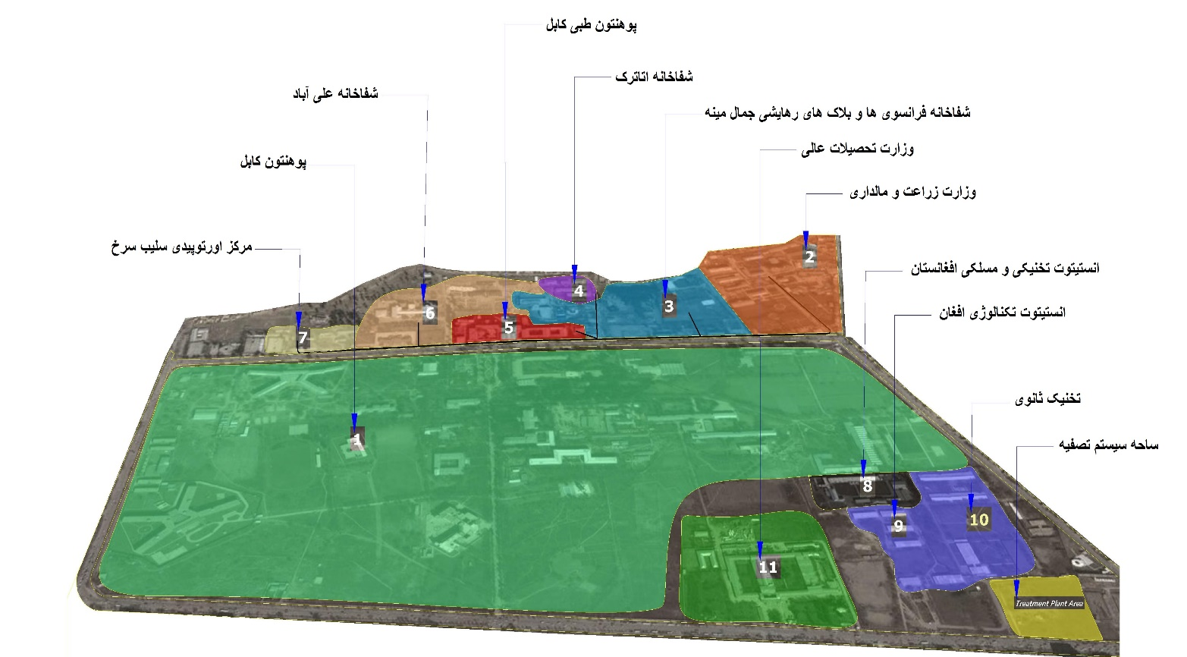
Wastewater Management Department
Kabul University and 11 related organization Topo
Kabul University
Ministry of Agriculture
FMIC and Jamal Mina Complex
Ataturk Hospital
Kabul Medical University
Aliabad Hospital
Red Cross Orthopedic Center
Afghanistan Technical and Vocational Institute
Afghan Institute of Technology
Secondary Technical Institute
Ministry of Higher Education

Slide 31
Get in Touch
With Us
Afghanistan Urban Water Supply and Sewerage Corporation (AUWSSC)
THANKS FOR YOUR
ATTENTION!
Karte e New, Sar e Tappa, District 8
Kabul, Afghanistan
www. http://auwssc.gov.af/

