Slide 1

MRRD/ASERD Presentation on Afghanistan Rural Energy- Off grid Interventions
July 2018

Slide 2

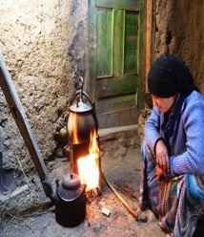
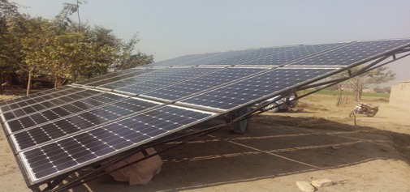
MRRD response to the situation
Part of MRRD’s mandate is provide energy for rural Afghanistan to ease development and poverty reduction
MRRD is tied to environment protection law in its interventions
MRRD is trying to reduce pollutions by trying to harness renewable energy; this covers indoor pollutions as a result of burring wood for cooking and heating and eliminating usage of gasoline in generators

Slide 3
ASERD in a glance
  OUTPUT 1: RURAL ENERGY SERVICES
  OUTPUT 2: POLICY AND REGULATION
  OUTPUT 3: INNOVATIVE DELIVERY MODELS
  OUTPUT 4: CAPACITY DEVELOPMENT AND OUTREACH
This program has plan to implement 25 mini-grids in 17 provinces in the country.
Achievements:
  Five projects are in procurement stages
  One project construction will be started this year
  Several workshops and trainings with academic organization’s cooperation took place
  Afghanistan Rural Renewable Energy Strategy (ARES) is finalized
  One MOU signed with MEW and ANSA for supporting standardization of design and implementation of Projects

Slide 4
Border districts electrification project
This intervention for providing access to electricity in border districts will:
  Cover 55 districts in 13 provinces
  Will serve around 382,000 households
The private sector will be engaged for implementation of this project and will provide the after sale services.

Slide 5
Citizen charter NATIONAL PROGRAM
(2017-2021)
The Citizens’ Charter will ensure the delivery of a basic package of services for all communities by 2026, based on community-led prioritization and gap analysis, communities will have at least one of the following:
  Basic electricity from renewable sources in remote areas which cannot be reached by the grid system;
  Basic all-year roads to increase village to market access; or
  Small-scale irrigation and drainage infrastructure.

Slide 6

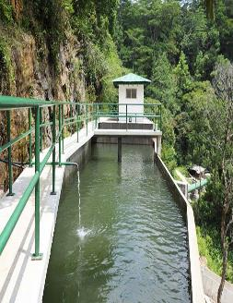
Government’s Mission
      (2017-2021)
Our objectives for the electricity and energy sectors are to:
    Reduce transport costs to expand rural-urban trade;
    Complete the 500kv national grid and become energy self-sufficient within 15 years; and
    Gain revenue from energy arbitrage between central and south Asia.
To get there Afghanistan will:
    Encourage private sector infrastructure development;
    Where possible, provide cleared government-owned land to accelerate strategically important infrastructure;
    Consolidate design and adopt innovative procurement to reduce tender and completion times;
    Train a cadre of infrastructure engineers and project managers;
    Increase domestic generation to 2,300 MW, using natural gas, renewable energy, and hydro-electricity;
    Develop domestic energy supplies and transmission, especially through renewables; and
    Normalize the pricing and subsidy regime.

Slide 7
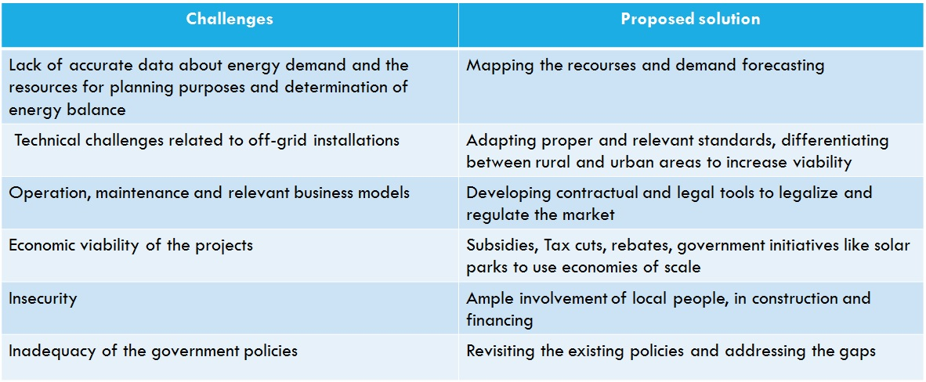
Challenges in executive level

Slide 8
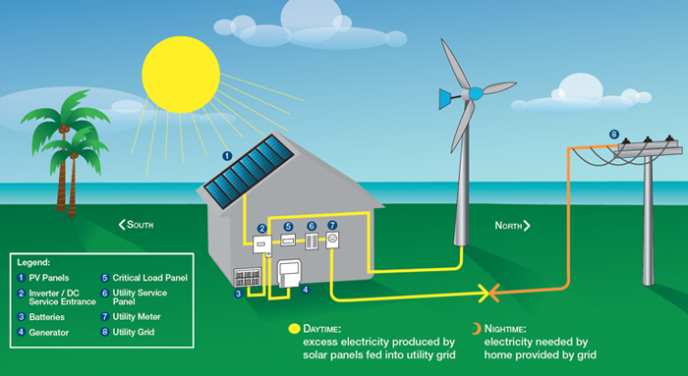
Thank You

