Slide 1
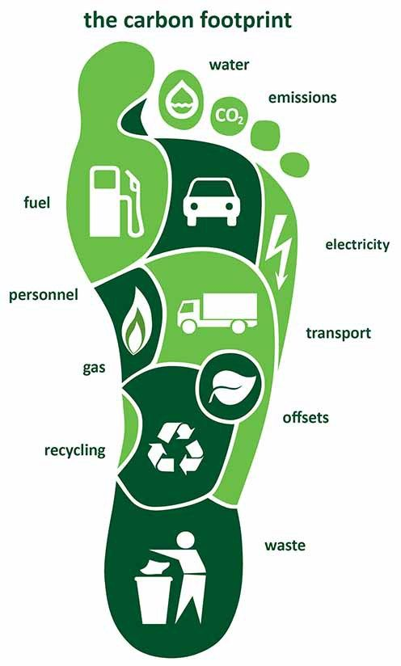
Energy Profile and Carbon Footprint of Afghanistan
Sanjay Vashist
Director
Climate Action Network South Asia
Kabul, JULY 2018

Slide 2
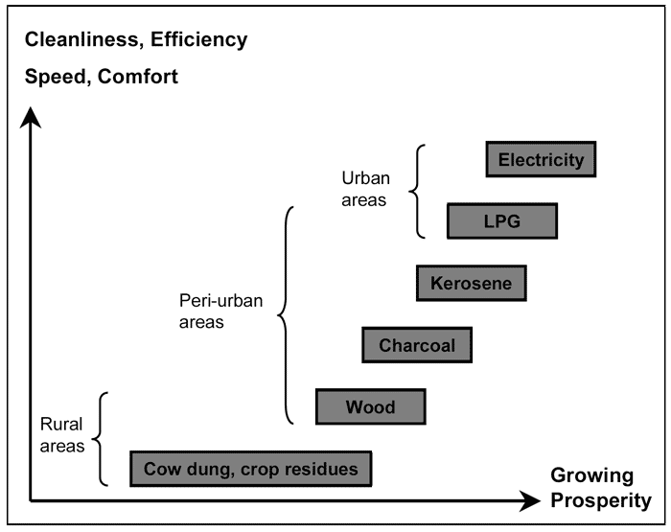
Energy Ladder…

Slide 3
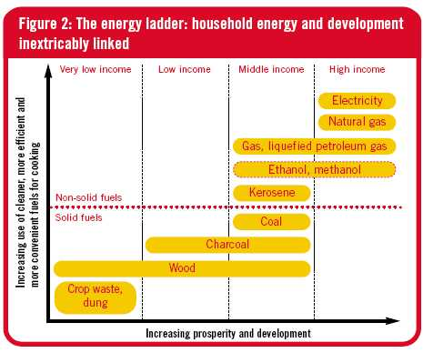
Energy Ladder as per Economic Sections…
In Afghanistan, Rural populations use local waste, solar panels, batteries, small wood, coal, kerosene supplies for basic cooking and heat.

Slide 4
Afghanistan Compact Benchmarks for Energy Sector…
“By end 2010, electricity will reach at least 65 percent of households and 90 percent of non residential establishments in major urban areas and at least 25percent of rural households.”
“By end 2010, at least 75 percent of the costs will be recovered from users connected to the national power grid”, a benchmark that the Government now intends to exceed for all but the poorest members of society.

Slide 5

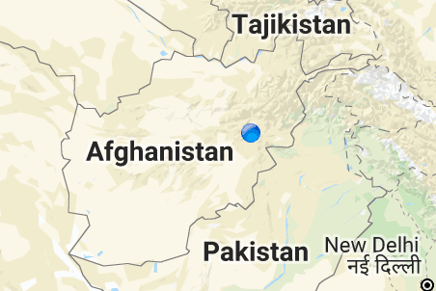
Energy Profile Afghanistan…
Electricity Access
  Total Population with electrification – only 43%
  Electricity Consumption – 4.741 billion kWH
  Electricity Production – 1.034 billion kWH
  Electricity Imports – 3.779 billion kWH (Deficit)
Electricity Sources
  Electricity from Fossil Fuels – 44.7 %
  Electricity from Hydro – 51.1%
  Electricity from RE – 0.2 %
43% electricity

Slide 6
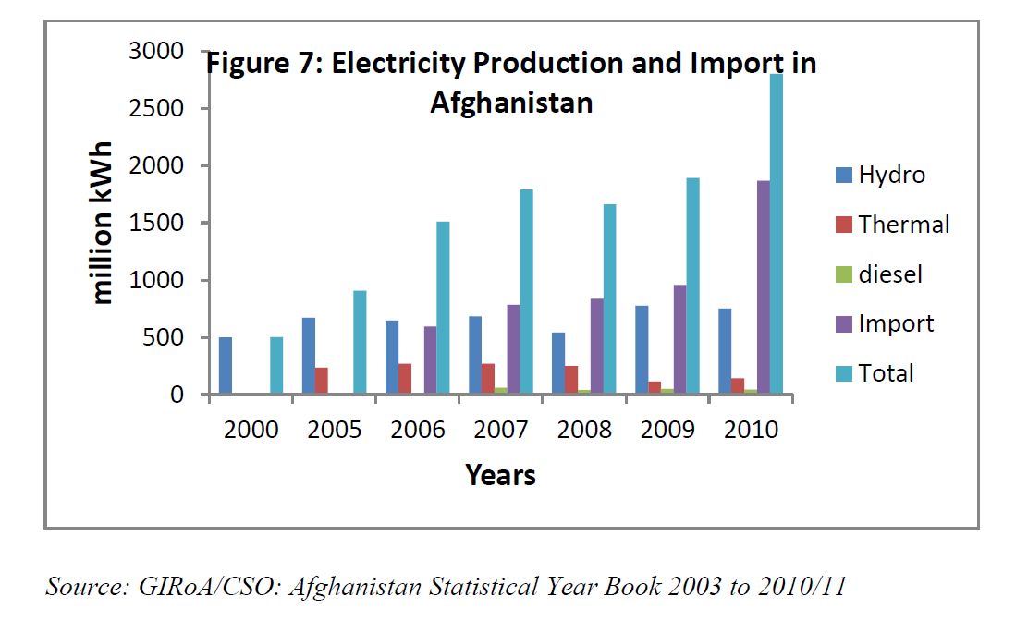
Energy Profile Afghanistan…
Increased Dependence on Hydro
Increasing bill of importing energy

Slide 7

GHG Profile Afghanistan…
Total GHG Emissions – 33.37 MtCo2
  1.02 t Co2e per capita / year
  119 % change since
Emissions from Key Sectors
  Energy – 9.77 Mt
  Industrial Processes – 0.38 Mt
  Agriculture – 14.79 Mt
  Waste – 8.42 Mt

Slide 8
Future Energy Potential…
Afghanistan is a Least Developed Country
Development agenda and peace keeping goes hand in hand
Carbon Footprint is not significant but will grow as the growth engines start picking up speed.
Clean, Predictable and Reliable Energy is still a distant vision for policy makers.
Diversification of Energy Sources remain a low priority
However -
  Estimated Afghanistan has 18,400 MW of untapped hydro
  Wind Potential is 158,100 MW of which a portion can be tapped at US $ 0.09 per kWh
  Estimates indicate that in Afghanistan solar radiation averages about 6.5 kWh per square meter per day and the skies are sunny about 300 days per year.

