Slide 1
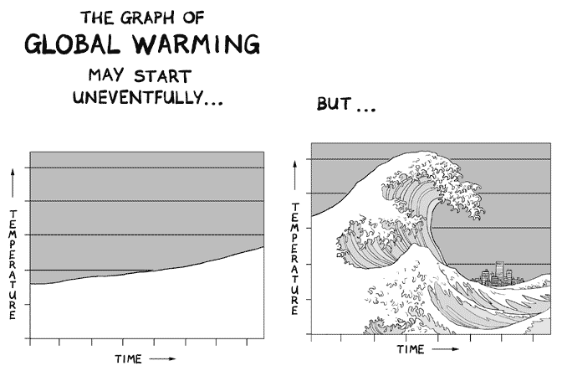
Climate Induced Hazards
Rushati Das, CANSA
National Workshop, Kabul, Afghanistan, July 2018

Slide 2
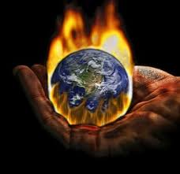
Causes of Climate Change…
GHG emissions from
Industrialization
Urbanization
Deforestation
Land use changes

Slide 3
The targets cover emissions of the six main greenhouse gases:
  • Carbon dioxide (CO2);
  • Methane (CH4);
  • Nitrous oxide (N2O);
  • Hydrofluorocarbons (HFCs);
  • Perfluorocarbons (PFCs); and
  • Sulphur hexafluoride (SF6)
Montreal Protocol

Slide 4
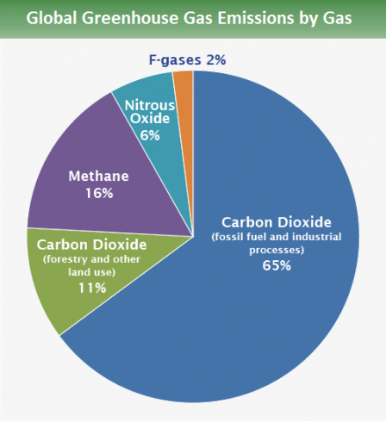
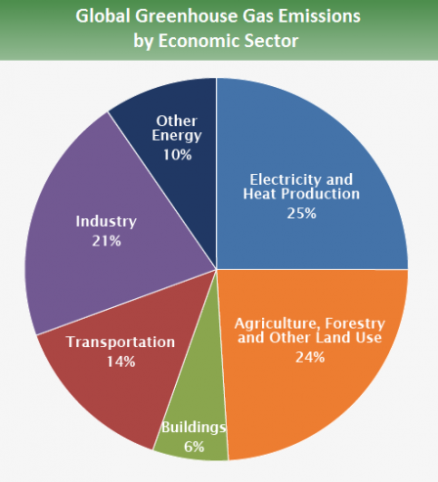
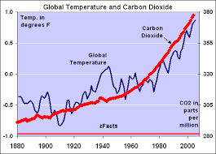
Carbon Accumulated in Atmosphere…
421 ppm already accumulated as of 2017
last 130 years, the world has warmed by approximately 0.85oC. Each of the last 3 decades has been successively warmer than any preceding decade since 1850

Slide 5
Climate Impacts in temperature rise scenario...

Slide 6
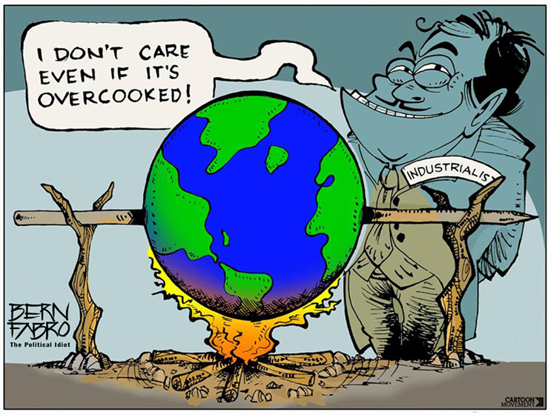
Climate Change Impacts

Slide 7
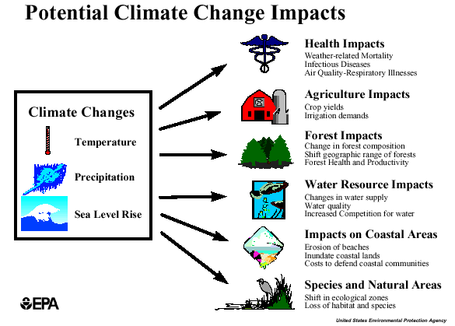

Slide 8
Impacts Reported…
Snow Melting = Sea level rise / Flash Floods
Loss of biodiversity = Growth of deserts / desertification
Droughts = loss of livelihoods / food / nutrition
Reduction in crop yields = Displacement / Migration
Floods = Loss of human lives / damage to infrastructure
‘Between 1994 and 2013, EM-DAT recorded 6,873 natural disasters worldwide, which claimed 1.35 million lives or almost 68,000 lives on average each year. In addition, 218 million people were affected by natural disasters on average per annum during this 20-year period.’ … UN office on DRR

Slide 9
Climate Hazards in Afghanistan
Ongoing Drought in 2018
  2 million people in 22 provinces affected
Floods and Landslides - Feb 2013
  1,600 families had been affected, 26 people had been killed, and about 425 homes had been damaged or destroyed in 15 of Afghanistan's 34 provinces
Flooding in May 2014
  affected 90,000 people - displacing 20,000 - in 14 northern provinces, damages exceeding $100 million
Notes:
Kabul province is also most affected
Droughts of various length and severity

Slide 10
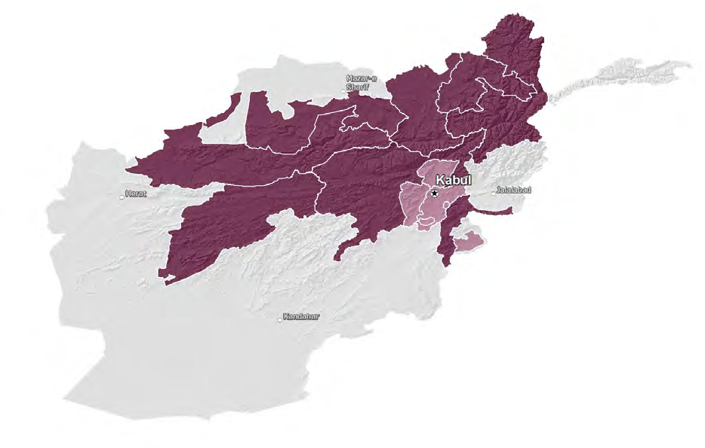
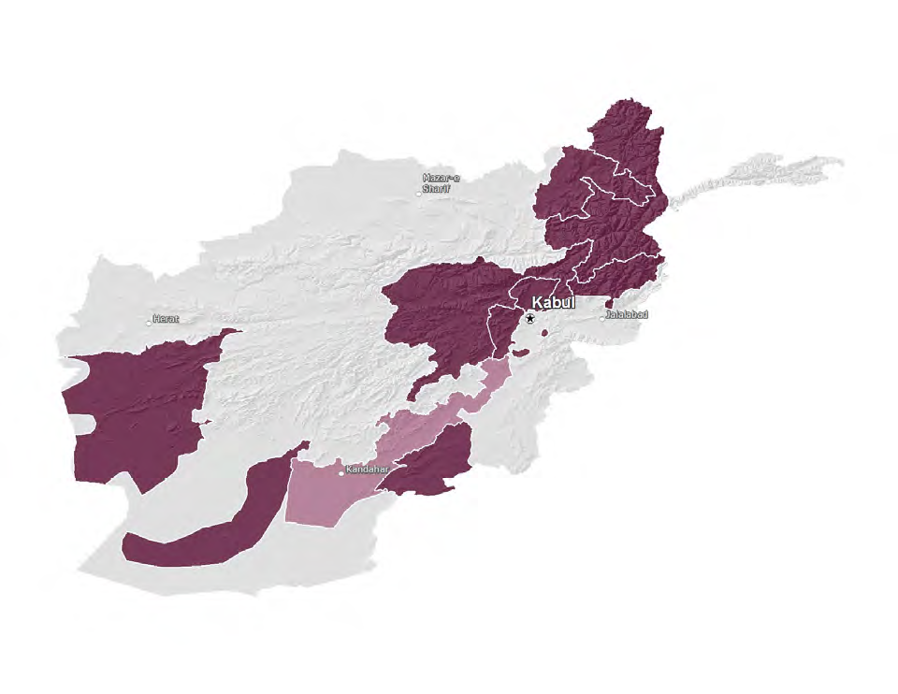
The climatic risk of rainfall-related drought has increased over the past thirty years across most of the country.
The occurrence of snowmelt-related drought—caused by reduced winter snowfall in parts of the Hindu Kush mountains— seems to have primarily affected Kabul and surrounding regions.
DROUGHT
Negative impacts of floods caused by heavy spring rainfall have been felt across a range of different livelihood zones
FLOOD

Slide 11
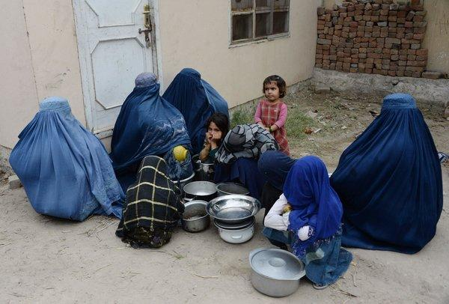
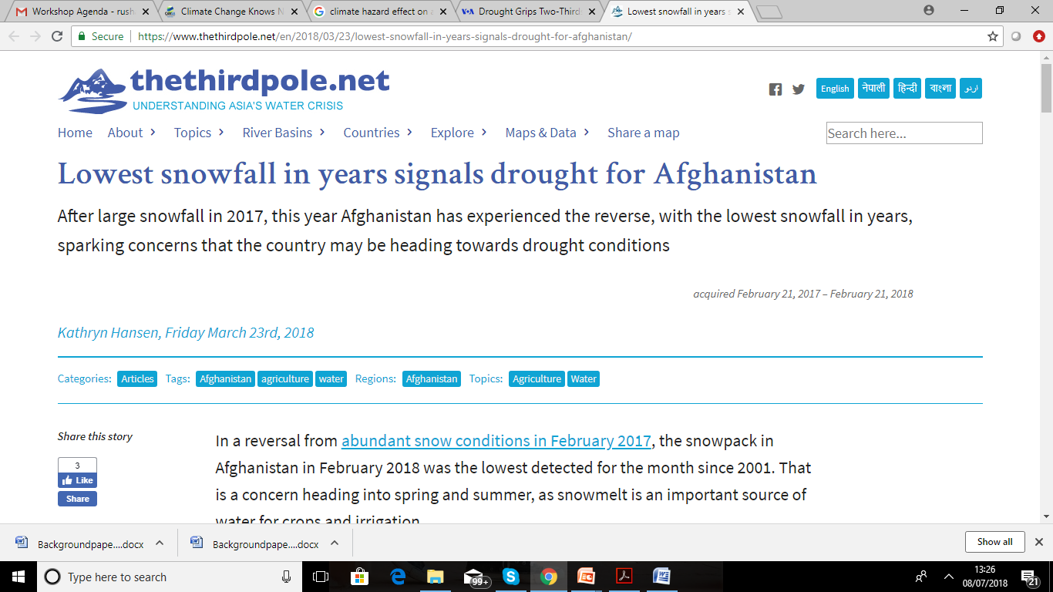
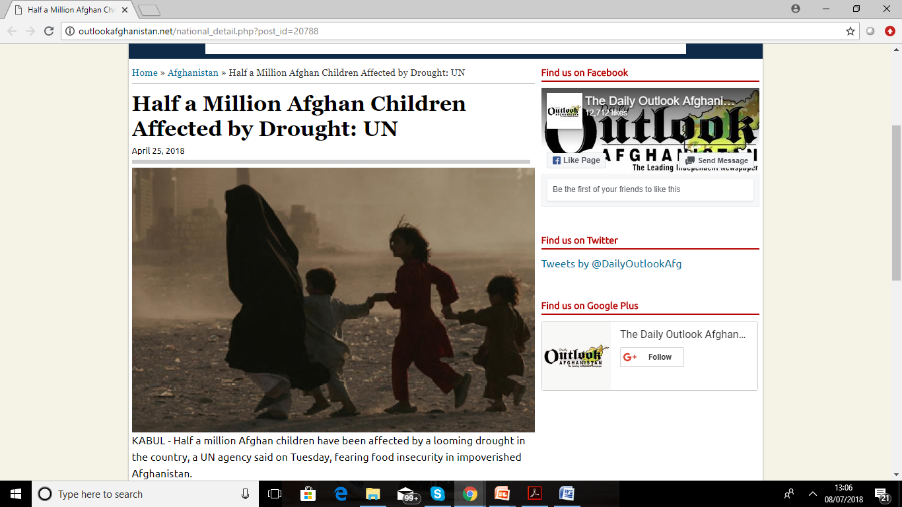
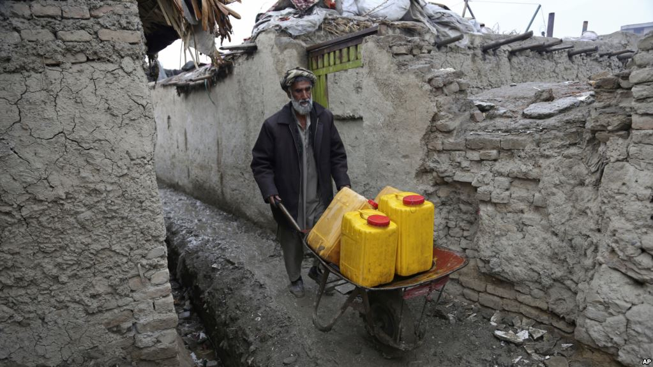
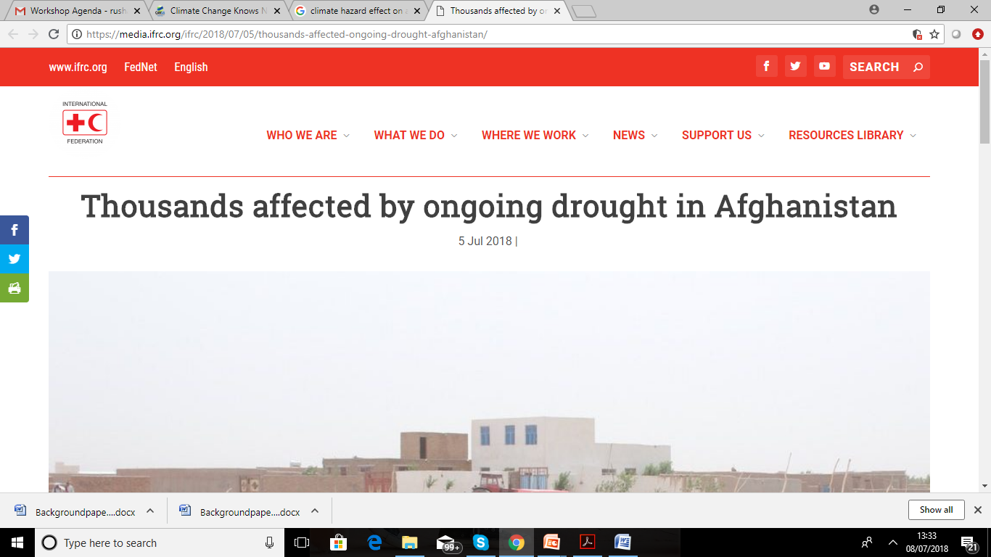
Climate Hazards reported in Afghanistan…

Slide 12
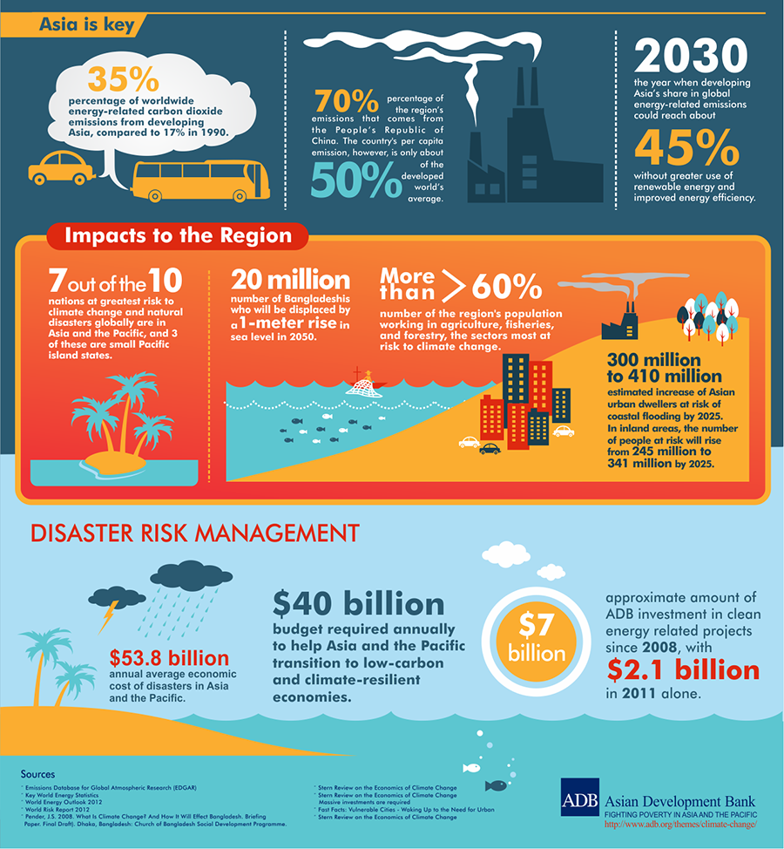
Vicious Cycle…
Polluters are also impacted !

Slide 13
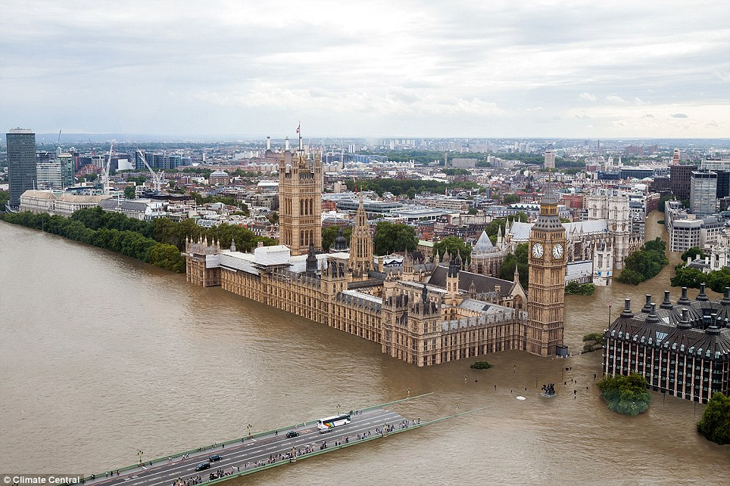
2016 Floods in United Kingdom…

Slide 14
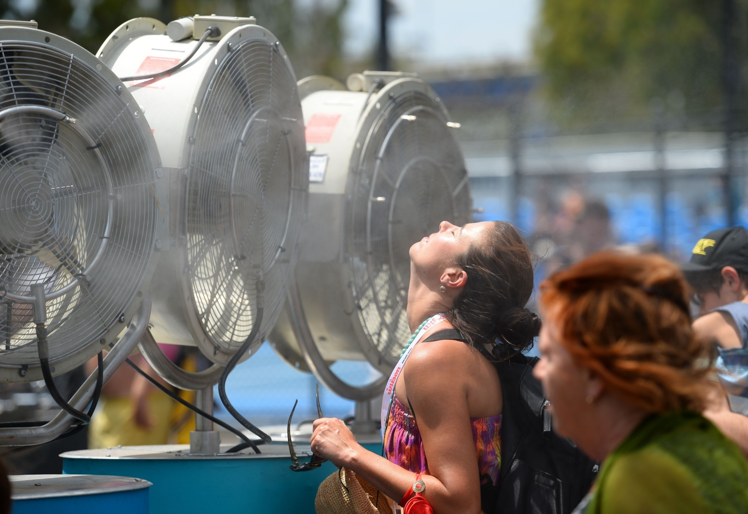
2015 Heat Waves in Europe…

Slide 15
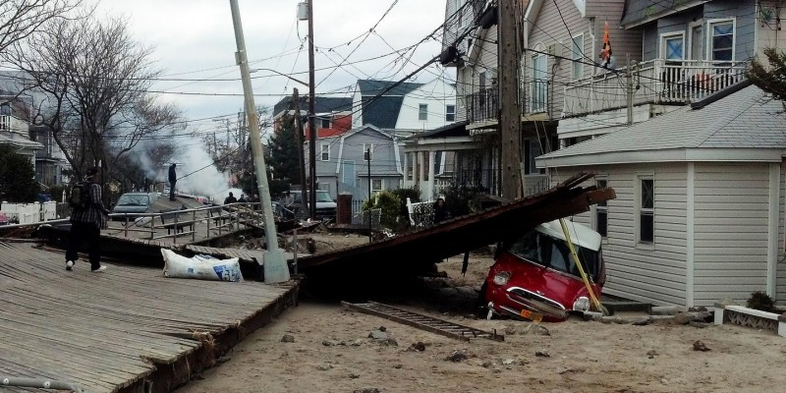
2016 Mathew Cyclone in America…

Slide 16
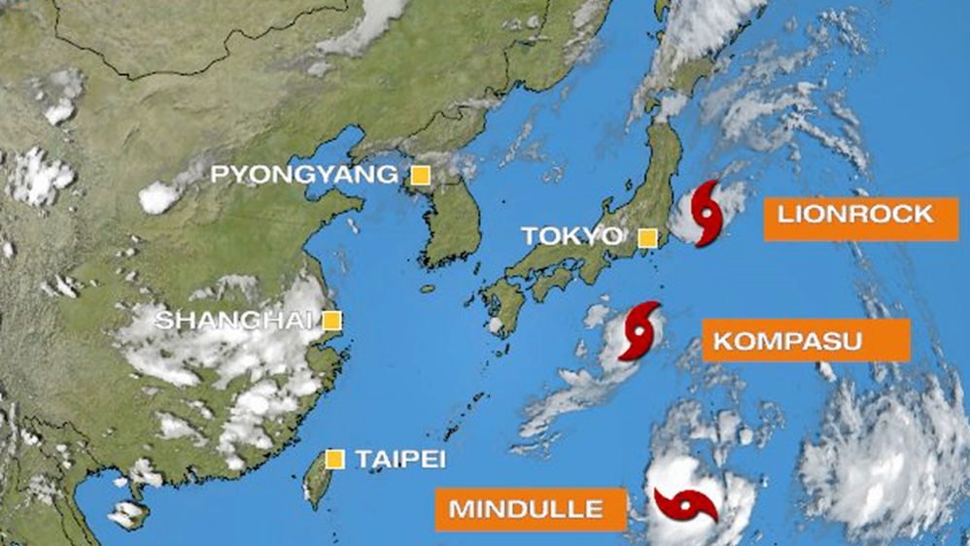
2016 Cyclone in Japan…
Three Cyclones at once !

Slide 17
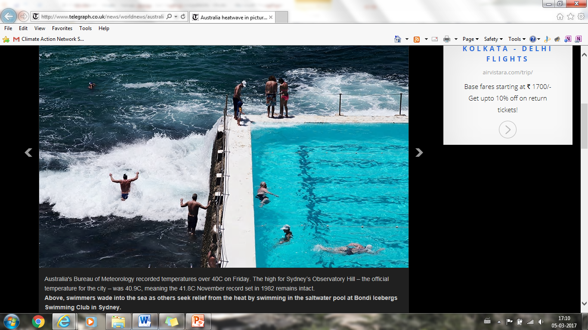
2016 Cyclone in Australia…

Slide 18
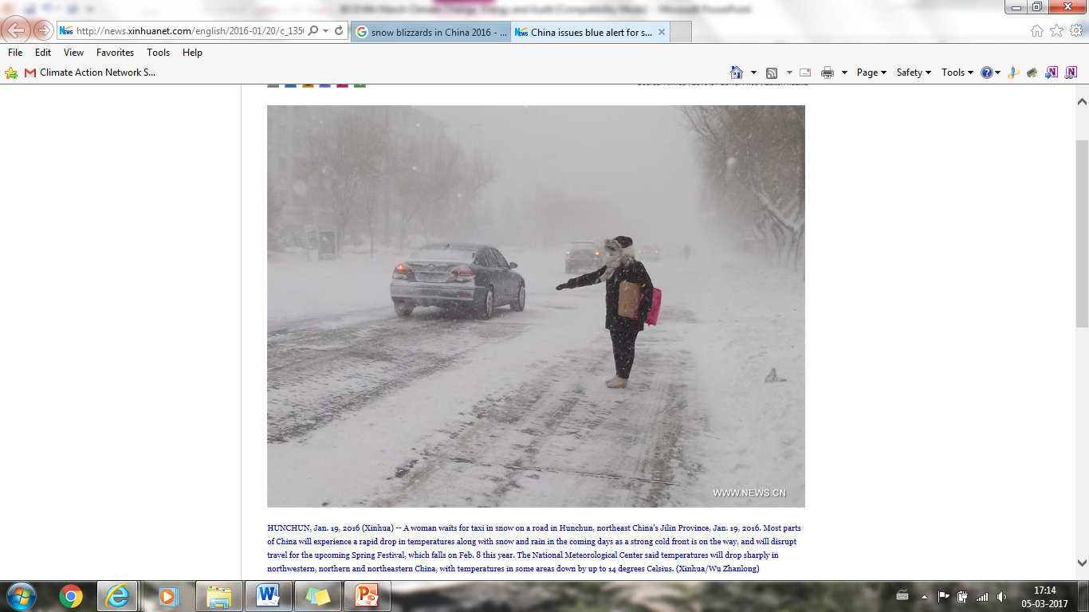
2016 Snow Blizzard in China…

Slide 19
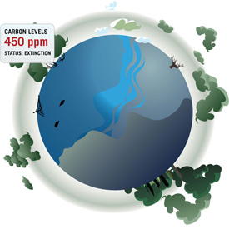
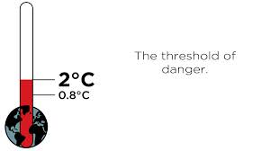
Global Goals to address Climate Change ?

Slide 20
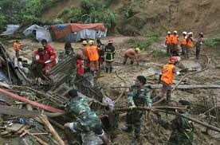
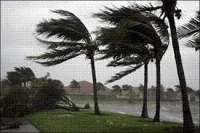
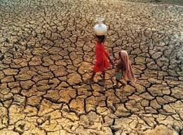
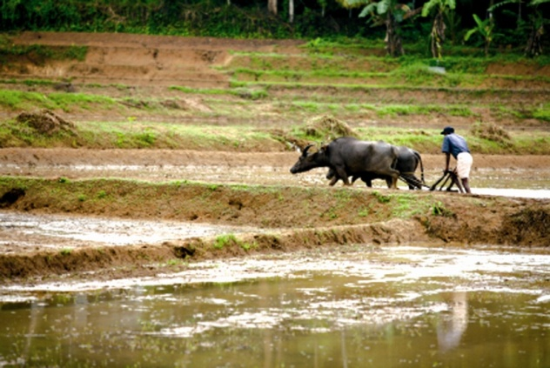
rushati@cansouthasia.net
@Rushati4
Thank you !

