Slide 1
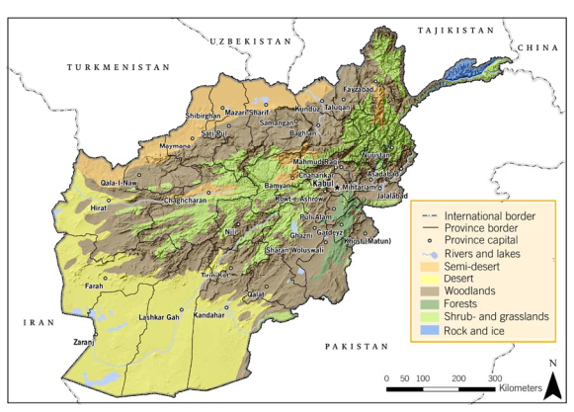
Climate Science and Vulnerability in Afghanistan
Santosh Patnaik
CAN South Asia

Slide 2
Climate Change and Afghanistan
Extreme heterogeneous geography of Afghanistan, ranging from the glacier-covered Hindu Kush in the north to the arid deserts in the south
Each decade; Afghanistan has lost 2% of its rain and snowfall due to Climate Change
Annual average temperatures has risen by 1.0°C to 3.0°C
in Western Afghanistan from 1950-2010 (World Bank report – South Asia’s Hotspots)
Average temperature across Afghanistan has increased by 0.6°C since 1960 (Tyndell Centre for Climate Change Research,2010)
Adaptation challenges facing Afghanistan are very significant in scope and scale (SEI 2009)
Karakorum will receive more precipitation due to an increase of westerly disturbances (Ridley et al. (2013)
Warming of 2 ◦C and a slight increase of precipitation (8–10%) until 2050 for the Upper Indus Basin, including its Hindukush part
Notes:
http://outlookafghan
istan.net/topics.php?post_id=20167#ixzz5KS7k9gZd)
For every 1 million inhabitants 1,150 people die in Afghanistan, 50% of these
fatalities from geo physical and weather related events

Slide 3
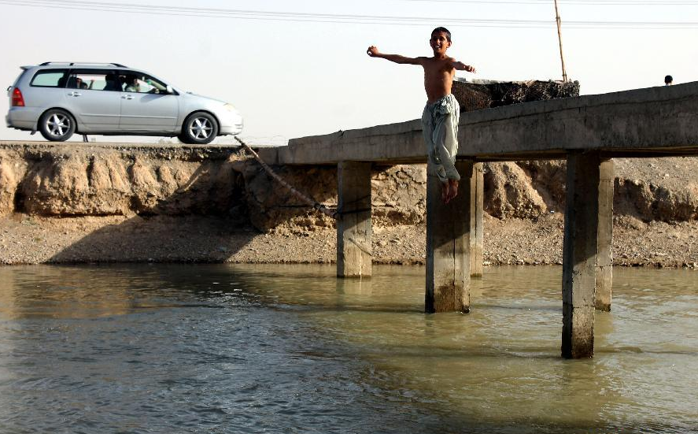
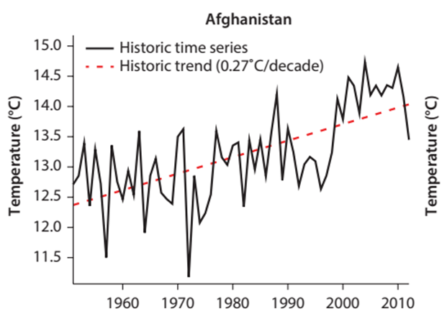
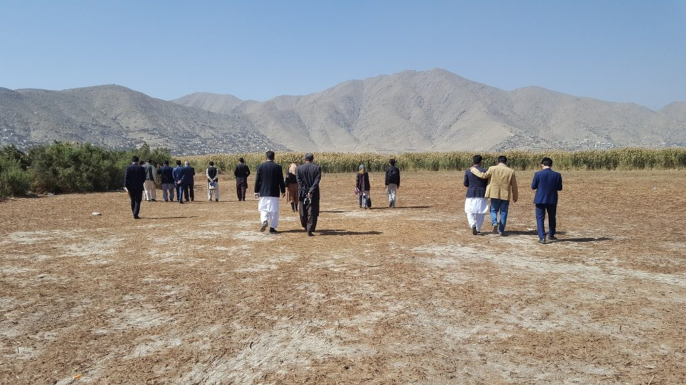

Slide 4
Impacts
Ongoing Drought in 2018
- 2 million people in 22 provinces affected
Floods and Landslides - Feb 2013
- 1,600 families had been affected, 26 people had been killed, and about 425 homes had been damaged or destroyed in 15 of Afghanistan's 34 provinces
Flooding in May 2014
- affected 90,000 people - displacing 20,000 - in 14 northern provinces, damages exceeding $100 million
Notes:
Kabul province is also most affected
Droughts of various length and severity

Slide 5
Contd..
Intense and recurring hazards, including earthquakes, floods, flash floods, landslides, avalanches and droughts
Flooding is the most frequent hazard
Second only to Haiti in terms of the number of fatalities from disasters between 1980 -2015

Slide 6
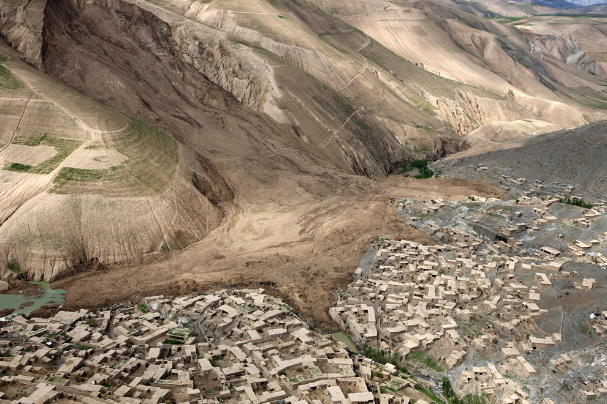
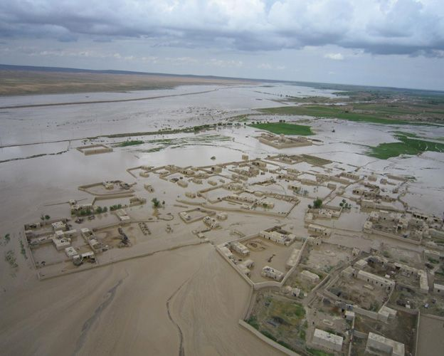
Landslide in Badakhshan
Submerged homes due to floods in Northern province of Afgahnistan

Slide 7
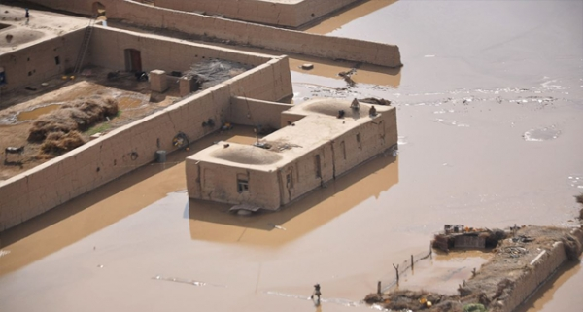
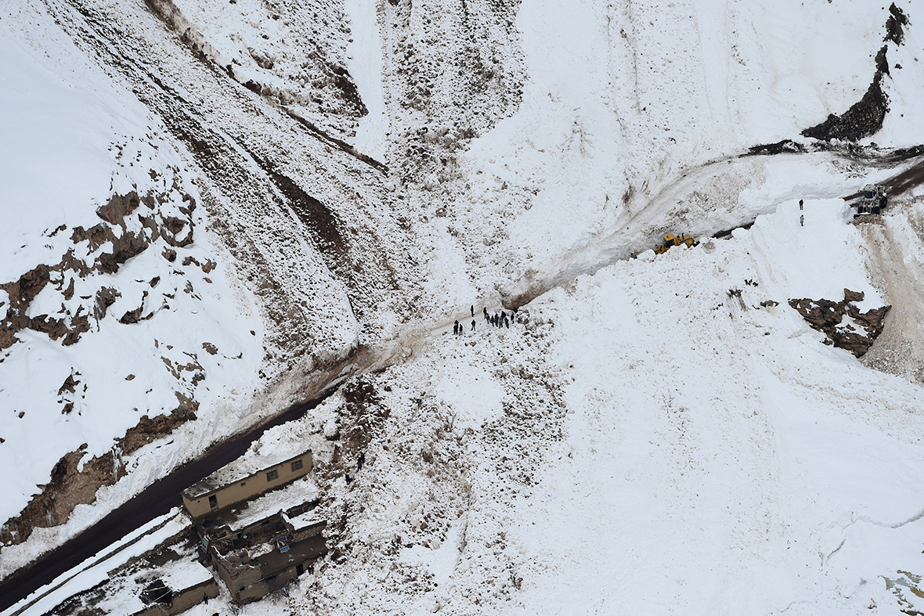
Flashfloods in Baghlan province
Avalanches in BadaKhshan province
Photo Courtsey : Sameera Noori, CoAR

Slide 8
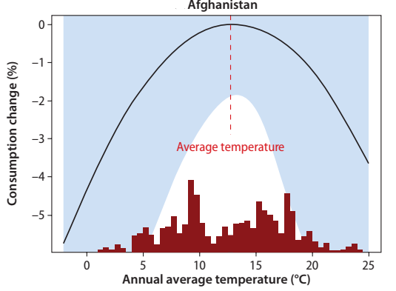
Positive Effects
A warmer climate can increase productivity in historically colder regions such as mountainous areas
Climate change may increase precipitation in some areas in Afghanistan
From 1950 through 2010, increasing monsoon precipitation are found for parts of eastern Afghanistan
Average temperatures in Afghanistan are still less than the inflection point, which means increases in temperatures are predicted to have a net positive effect on consumption

Slide 9
Climate Parameter | Vulnerability | Impact
Rise in extreme temperature | Low adaptive capacity and high exposure to climate fluctuations Geographic parameters such as low latitude and continentality | Heat Wave reduces in agricultural and labour productivity, Decline in health indicators due to vector borne diseases - Climate induced migration, and other factors that affect economic growth and poverty reduction
Erratic rain and snowfall | Water sources are heavily dependent on annual rainfall and snowfall Subsistence Agriculture is the main source of livelihood Rain-fed agriculture (Spring precipitation) is predominant (16.4%), while only about 7% of the land is available for irrigated agriculture | Leads to drought and over exploitation of ground water threatens the grasslands and crop productivity Recurrent droughts is expected to affect hydropower production
Rapid snow melt and extreme rainfall | Mountainous landscape Poorly built flood protection infrastructure - Lack of early warning systems Increasing settlements in flood prone areas Lack of vegetation in mountain tops and denuded hills adds to severity of floods Lack of proper drainage causes urban flooding Lack of robust early warning system | -Flooding in rivers due to steep slopes - Erosion that harms agriculture - Loss of lives and livelihood

Slide 10
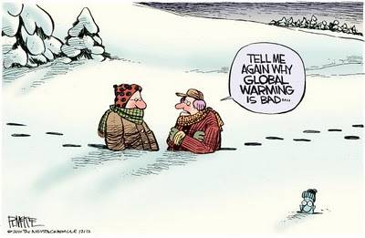
Science of Climate Change

Slide 11
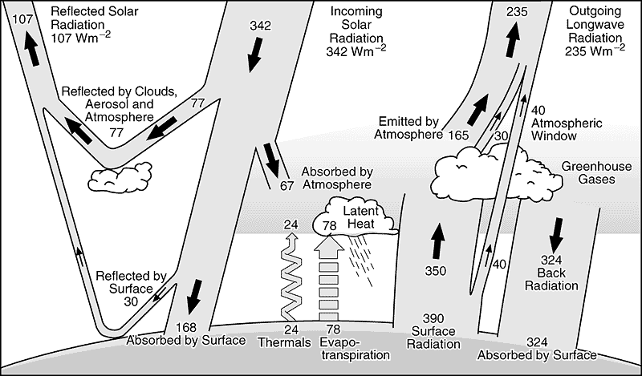
Energy budget and greenhouse effect
The delicate balance between the incoming short wave (ultra violet) radiation and the outgoing long wave (infra red) radiation maintains earth’s surface temperature at a level sufficient to support life on the planet
Some gases (called greenhouse gases) present in the earth’s atmosphere (in trace amounts) trap the outgoing radiation, raising the temperature of the earth’s surface – the phenomenon is commonly known as greenhouse effect

Slide 12
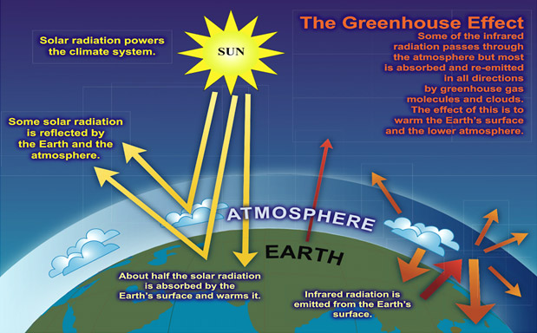

Slide 13
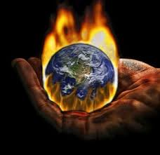
Causes of climate change
GHG emissions from
Industrialization
Urbanization
Deforestation
Land use changes

Slide 14
The six main greenhouse gases:
  • Carbon dioxide (CO2);
  • Methane (CH4);
  • Nitrous oxide (N2O);
  • Hydrofluorocarbons (HFCs);
  • Perfluorocarbons (PFCs); and
  • Sulphur hexafluoride (SF6)

Slide 15
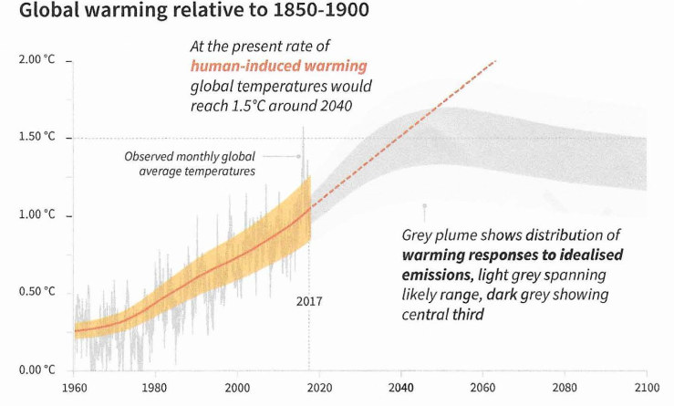
Leaked IPCC 1.5C draft report
In 2015, Paris Agreement established twin goals to hold temperature rise from pre-Industrial times “well below 2C” and strive for 1.5C.
The world is warming roughly 0.2 C each decade.

Slide 16
Thank You

