Slide 1

Ministry of Refugees and Repatriation
Migration and Climate Change
Prepared By: Sultan Ali Javid | July 2018

Slide 2
Background
According to the United Nations (UN), as of 2015 approximately 244 million people were living outside their country of birth, and another 740 million were either internally displaced or had moved within their country (UNDESA, 2016a)
In 2016, over 24 million people were newly displaced by sudden-onset climate-related hazards, such as typhoons and floods
Afghanistan; The income of more then 61% of the total population depend on agriculture, and accounts for 44% of employment (self-employed or salaried). The political instability, poverty and natural disaster has serious effect on migration:
Rural Area to Urban (IDP)
Cross border Migration ( Refugees)
Migration: the process of moving within or across borders, either temporarily, seasonally or permanently.
Displacement: refers most commonly to instances where there is no choice but to move, either temporarily or permanently, within or across borders.

Slide 3
Factors that influence human mobility
Political
Economic
Cultural
Environmental
Social

Slide 4
Global Regime (SDG Target)
Sustainable Development Goals (SDGs) and targets on both climate change and migration, though explicit links between the two are absent. The Global Compacts on Migration and Refugees, to be finalized in 2018, offer scope for climate risk-informed action
The UN Secretary-General António Guterres:
He called for a new international protection framework for people who have been forced to leave their own country and who may not qualify for refugee status under international law, including those displaced as a result of catastrophic environmental events
Ministry of Refugees and Repatriation with technical support of ICMPD has also working on a comprehensive migration policy in which Migration and climate change is one of the objectives.

Slide 5
Some Statistic on Climate change and Migration
Country | Displaced | Reasons for Displaced
China | 1,990,000 | River Flood
China | 2,000,000 | Typhoon
India | 1,670,000 | Flood
Philippines | 4,968,971 | Typhoon
Indonesia | 948,098 | Rainy season floods and landslides
USA | 875,000 | Hurricane
Cuba | 1,079,214 | Hurricane

Slide 6
Forecasting of Mobility due to Climate Change
In 2006, the Stern Review suggested that, by 2050, 200 million people would be affected by climate change that could induce human mobility (Stern, 2006).
The non-governmental organization (NGO) Christian Aid has forecast that a billion people may be displaced by 2050 as a result of environmental causes, albeit not climate change alone (Christian Aid, 2007).
Others have estimated the number of ‘climate migrants’ at between 25 million and 30 million a year (Myers, 1997; El Hinnawi, 1985).
A recent report by the Environmental Justice Foundation (EJF, 2017) suggests that sea-level rise will lead to the displacement of hundreds of millions of people by 2100

Slide 7
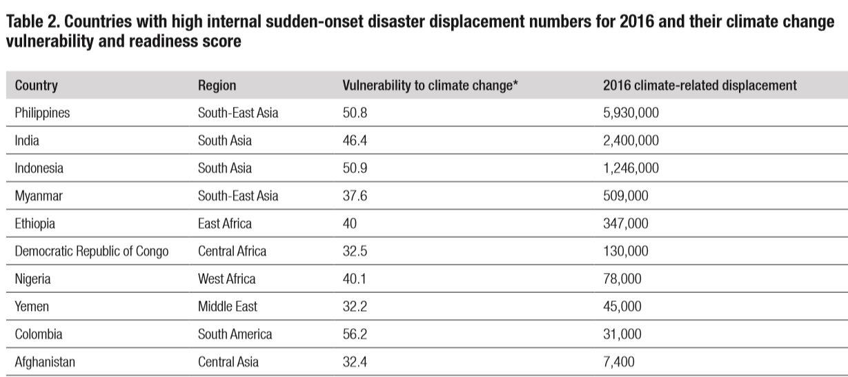
The top five countries in terms of numbers of IDPs in 2016 were the Democratic Republic of Congo, Syria, Iraq, Afghanistan and Nigeria

Slide 8
Migration as adaptation| Opportunities and challenges of human mobility
Opportunities | Challenges
New Economic Activities | Disrupted Social Network
Poverty Reduction | Labour Exploitation
Increase Wages | Access to Critical Services
Mobility holds both opportunities and challenges for those moving, for the hosting population and those who are left behind

Slide 9
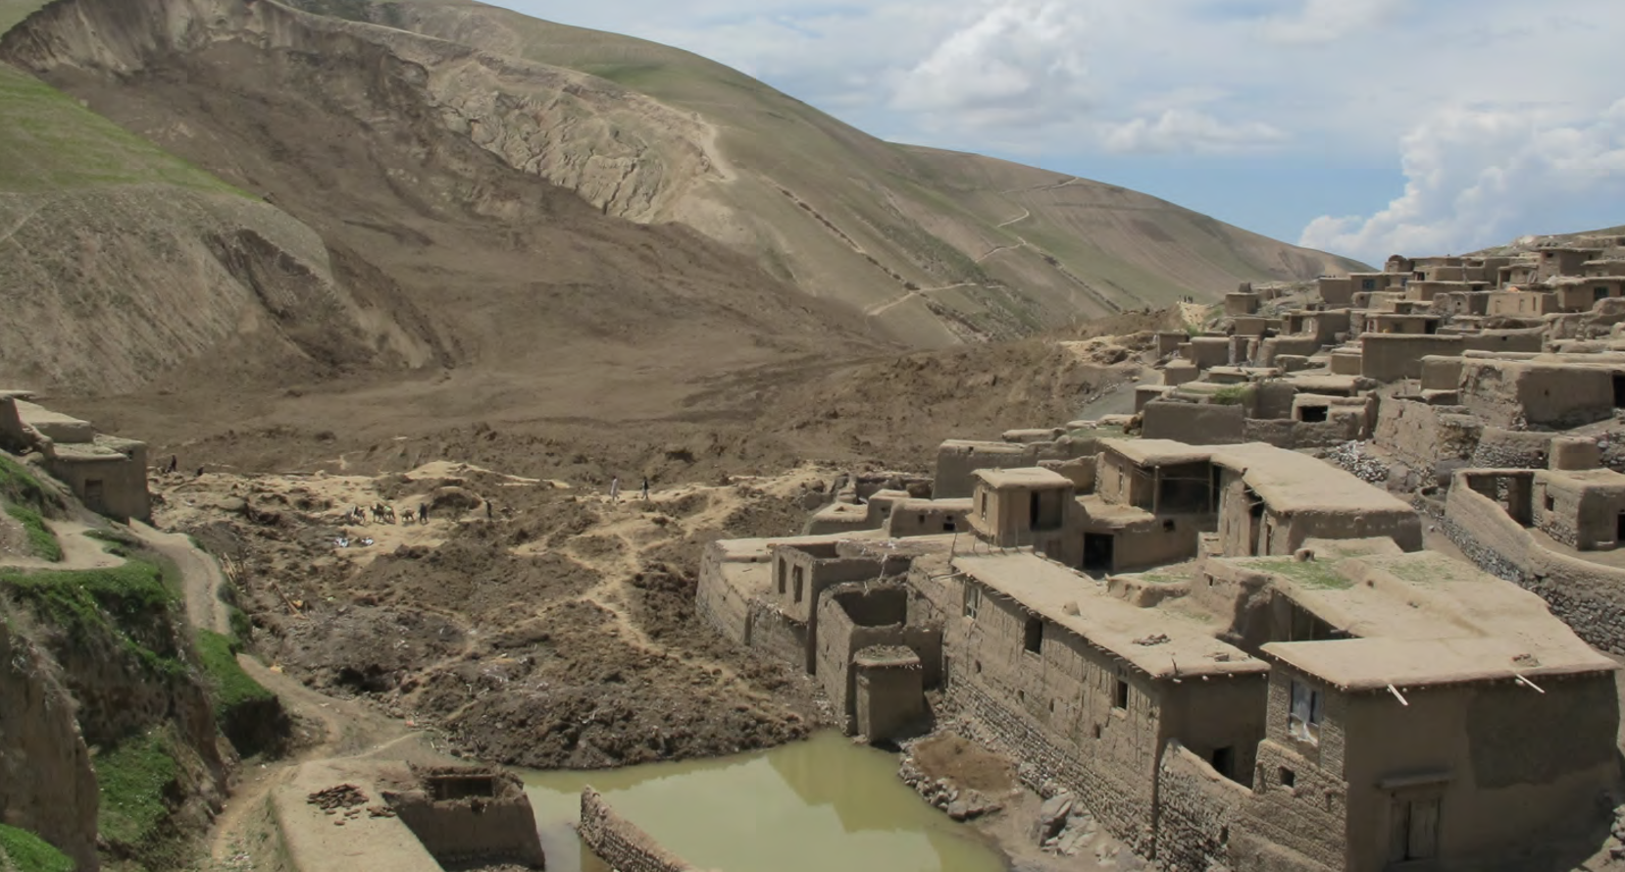
Afghanistan, The impact of climate change

Slide 10
The impact of climate Change in Afghanistan
Type of Climate Change in Afghanistan
Lack of Spring Rainfall
Reduced Snowmelt in upland areas
Heavy Spring Rainfall
Increased Snowmelt in Highland Areas
Drought
Flood

Slide 11

Afghanistan: Future Risk Under Climate Change
temperature increase
S 1st. 2.3⁰C/2015 - 2.3⁰C/2100 |HE|
S 2nd. 1.7⁰C|2050 - 2⁰C/2100 |LE|
Change in Spring Rainfall
Year 2021-2050| Increase up to 10% and in some part significant decrease in
Change in Winter Precipitation
Change in Spring and Summer Heavy Precipitation
2021 – 250| decrease between 0-10% across the country - except in the Wakhan corridor
Decrease more than 5> |Most part|2021-2050
Decrease 0-5%| Some Part of the country|2021-2050
Economic Migration due to decrease in agricultural activities |Distraction of agricultural land and Drought|
Increase in temperature (1.5⁰C to 2.5⁰C) and growing season length, agricultural and crops production decreased due to lack of adaptation strategy.

Slide 12
Possible mobility responses to different climate hazards
Natural Occasion | Hazards | Policy Recommendation
Slow onset | Soil gradually dries but access to irrigation allows people to continue planting | Stay and Adopt
Slow or repeated Sudden onset | Sea – Level rise coastal erosion inundate land and homes permanently | Migrate on a long – term basis
Sudden Medium Onset | Drought or persistent heat waves reduce crops yields and income, contributing to movement | Migrate on Cyclical temporary basis Migrate on a long – term basis
Sudden Onset | Flood, Storm or Cyclone temporarily displace people until infrastructure is restored. | Displacement

Slide 13
Recommendations
Climate Change, especially the migration due to climate change is a global issue, the government will have to come up with a scientific solution
The problem pf climate change should be on the top priority and the government will have come up with a comprehensive policy
Climate Change migration is just similar to other displacement and mobility, so there should be equal behavior with these type of migrants
The government will have to support the private sector for adaptation.

Slide 14

Thanks!
Sultan.javid@gmail.com

