Slide 1
Recap of Day 1
National Consultation to frame Climate Resilient and Carbon Neutral Agenda for Afghanistan
Hotel Kabul Star, Kabul
8th-9th July 2018
Santosh Patnaik
CAN South Asia

Slide 2
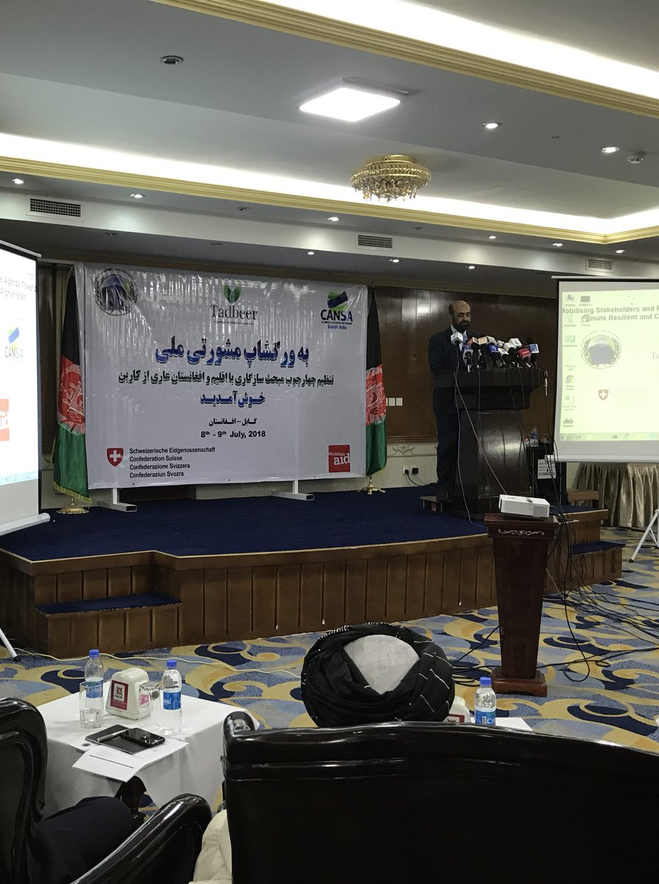
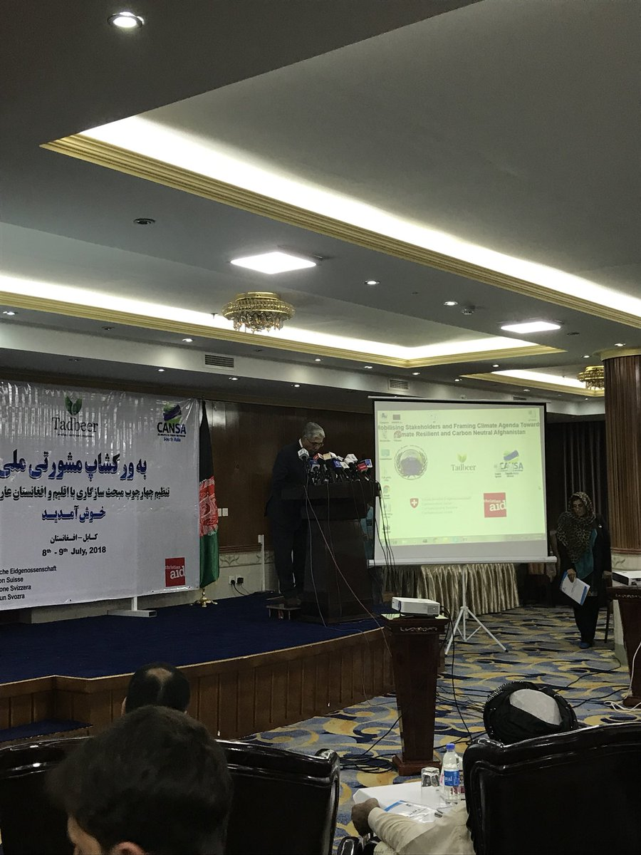
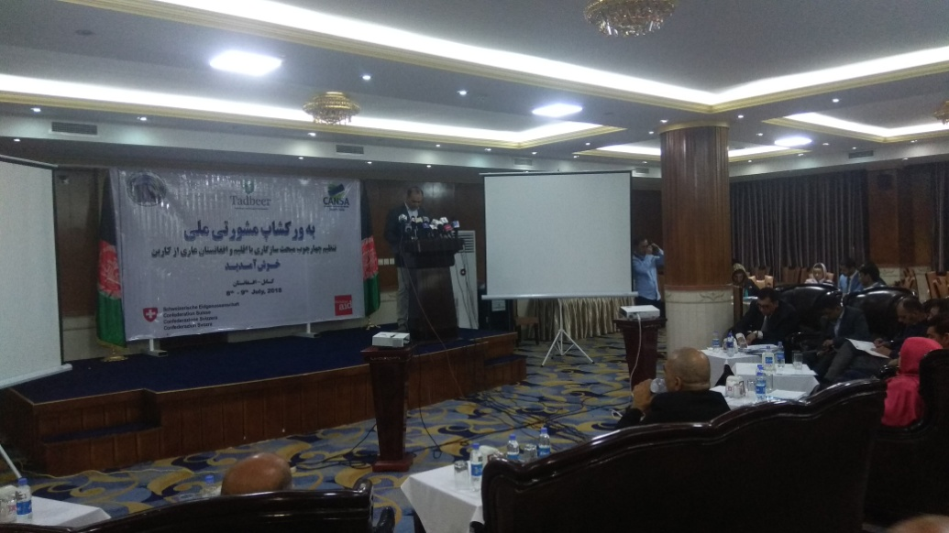
Inaugural Session

Slide 3
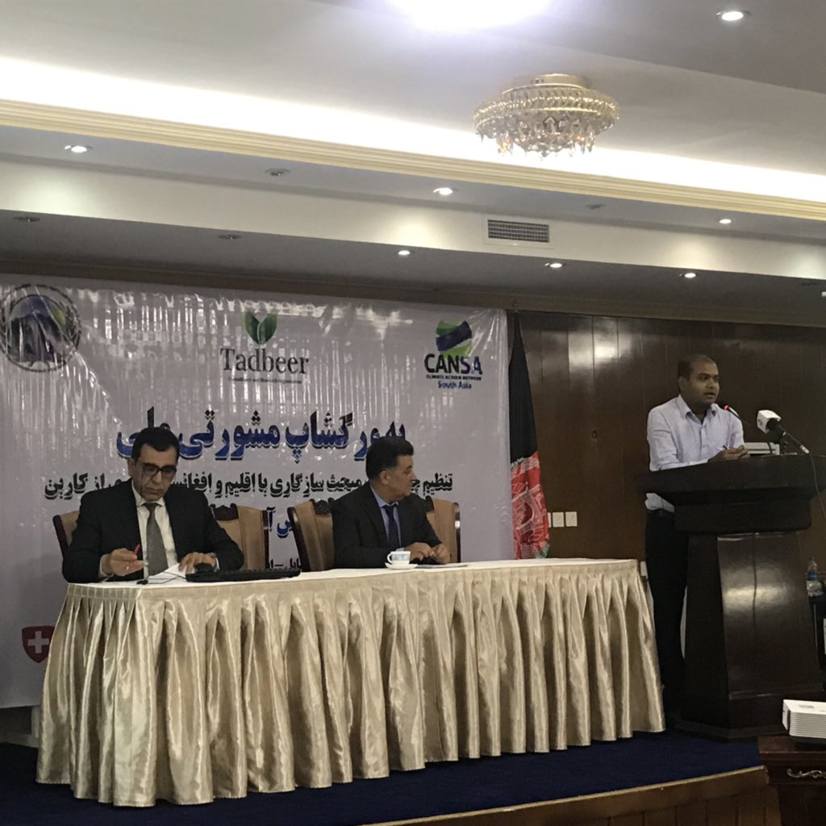
Session 2

Slide 4
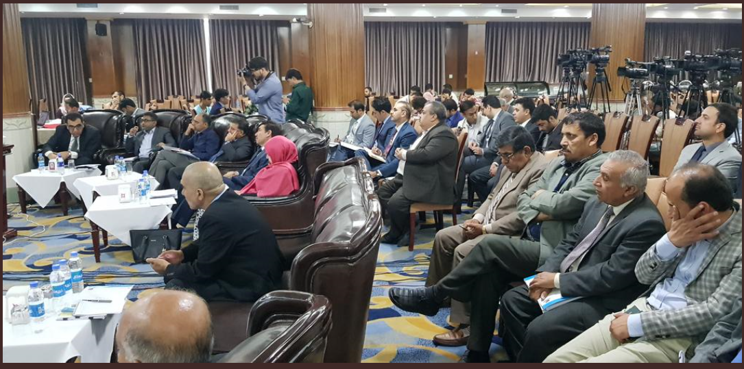
Session 3 - Impact of Climate Change on Agriculture Sector
Ministry has devised a strategic focus as a solution to improve agriculture sector
Factors of production, commodity focus, support services, improve livelihoods and promote institutions
- Strategic priorities have been identified in the sector
Improving irrigation systems, increased wheat production
Horticulture value-chain, livestock development
Climate-sensitive natural resource management
Food and nutrition security, and resilience building
Institutional reform
Agribusiness charter has been framed
Promote Water, energy and food nexus

Slide 5
The Liaison Office Environment and Natural Resource Dept (TLO ENR Dept)
Recommendations to Government
Increase interaction with communities regarding climate change and effective Community Based Forest Management
Strict rules and legal action against people involved in forest cutting, to prevent deforestation;
Introduce alternative energy sources with reasonable prices for fire wood (heating in winter, daily household consumption)
Increase reforestation and afforestation besides forest management

Slide 6
Recommendations to TLO
Focus on community awareness and empowerment;
Expand community based nurseries and reforestation;
Increase/expand watersheds rehabilitation and management;
Identify challenges and problems rural communities are facing and propose viable recommendations to communities and policy makers for effective and sustainable responses.
Initiate long-term programs and sustainable solutions

Slide 7
Session 4: Climate Constrained Water Sector
Afghanistan Urban Water Supply and Sewerage Corporation (AUWSSC)
Efforts to improve water supply is ongoing in
Survey and design of projects with various donor agencies
creation and operation of wastewater treatment plants is ongoing
Collection and use of biogas for various purposes
Reuse of sludge as fertilizer and reuse of water for irrigation

Slide 8
Ministry of Rural Rehabilitation & Development (MRRD)
Rural Water Supply Sanitation & Irrigation Program (RuWatSIP)
Revision of WASH policy based on SDGs requirements.
ODF Afghanistan by 2025

Slide 9
Thank You

