Slide 1

Ministry of Rural Rehabilitation & Development (MRRD)
Rural Water Supply Sanitation & Irrigation Program (RuWatSIP)
Sanitation & Hygiene Component of RuWatSIP
2018

Slide 2
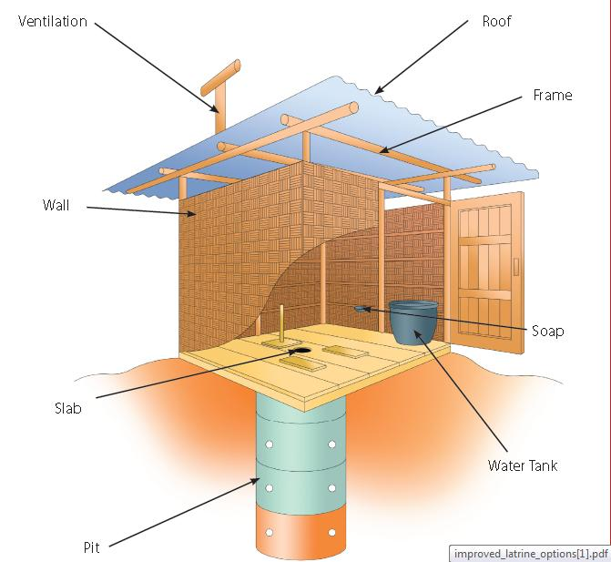

Sanitation in Afghanistan
Open Defecation
14% (18% Rural)
Environmental/ground water contamination due to OD and low latrine coverage
Improved Sanitation
39% (33% Rural)

Slide 3
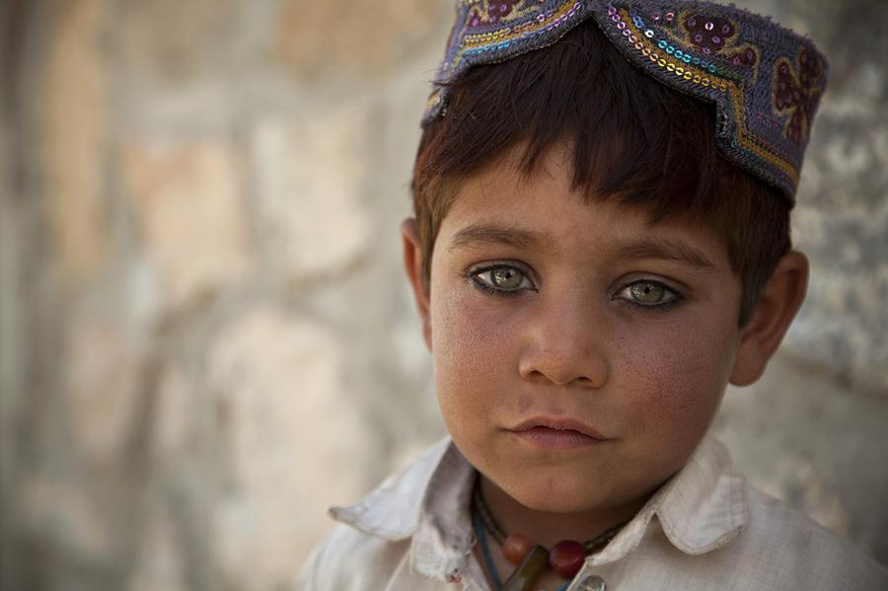
Under Five Child Mortality
U5CM Rate: 55/1,000
20% is due to diarrhea caused by WASH related diseases

Slide 4
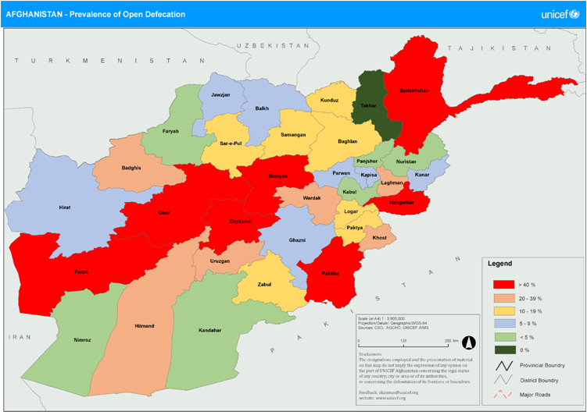
MRRD & WASH
High Open Defecation (OD) provinces identified (Bad sanitation environment)

Slide 5
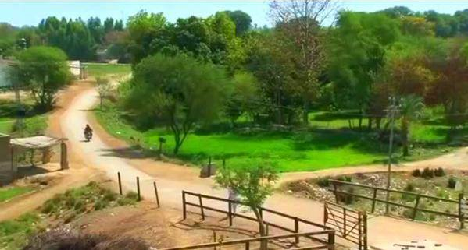
MRRD & WASH
ACM consists:
Excreta Management
New Latrine Construction & old latrine improvement
Sanitation village cleaning campaigns
Clean village declaration

Slide 6
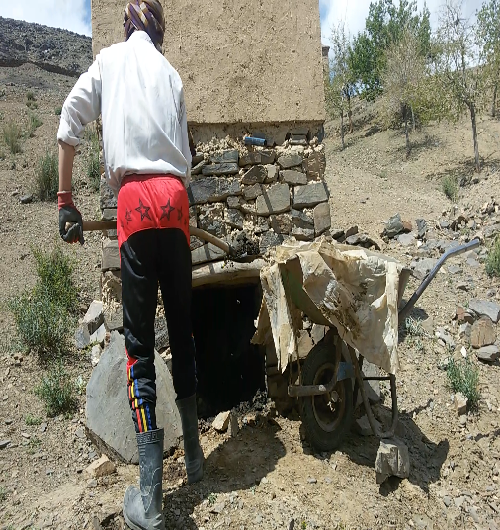
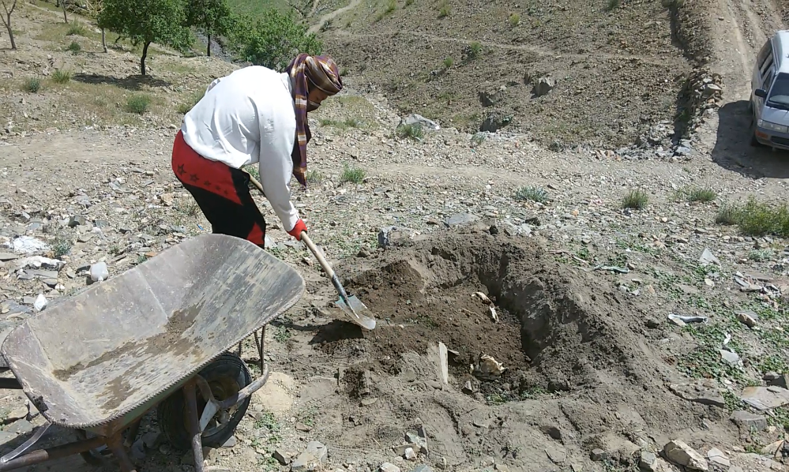
Traditional Excreta Management

Slide 7
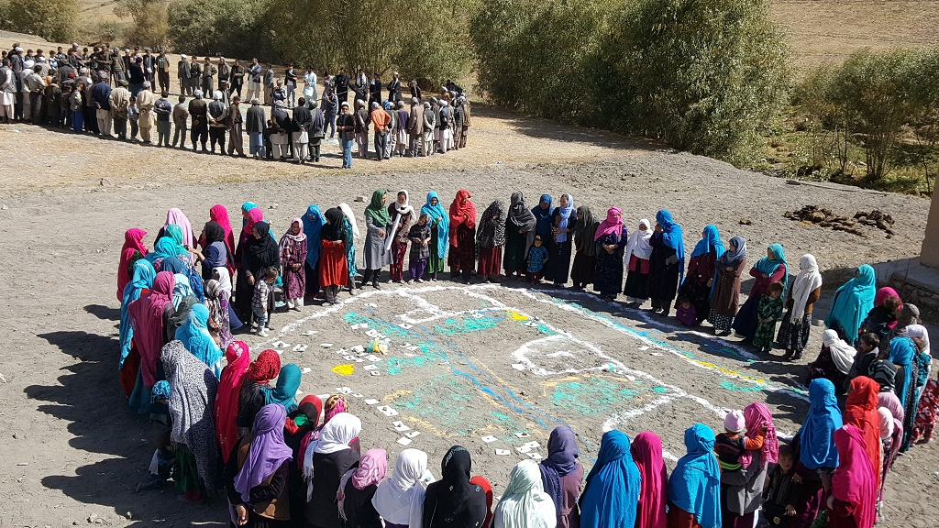
MRRD & WASH Sector Plan
National Movement under Afghanistan CLTS Movement (ACM) launched in 2016 under MRRD leadership
CLTS Teams
20 different NGO teams
MRRD & MoPH CLTS team
Achievements
Over 2,000 communities ODF
7 districts declared ODF
Next Step
ODF Afghanistan by 2025
Revision of WASH policy based on the SDGs requirements.

Slide 8
Thank You

